Slide 1
Report of Proactive Disclosure Subcommittee
Meeting of the FOIA Advisory Committee Washington DC October 21, 2014

Slide 2
FOIA requires agencies to proactively disclose certain information.
Publication in Federal Register per sec. (a)(1)
Description of agency’s organization
Requirements to which public is subject (e.g., regulations, forms)
Agencies meet requirement through U.S. Gov’t Manual, publication in FR, incorporation by reference in FR notices, etc.

Slide 3
FOIA requires agencies to proactively disclose certain information.
(Electronic) Reading Room or publish & sell, sec. (a)(2)
Opinions and orders adjudicating cases
Statements of policy adopted but not published in FR
Administrative staff manuals and instructions to staff that affect a member of the public
Records already released under FOIA which are likely to be subject of subsequent requests
Index to all of the above

Slide 4
Guidance encourages more proactive disclosure.
“…agencies should take affirmative steps to make information public. They should not wait for specific requests from the public.” – President’s memorandum of Jan. 21, 2009
“…agencies should readily and systematically post information online in advance of any public request.” – Attorney General’s memorandum of Mar. 19, 2009

Slide 5
DATA Act
Builds on USASpending.gov disclosures about grants, contract awards and loans
Adds data about budget, commitments & expenditures, reprogramming, and fund balances
Requires:
Bulk download, machine readability
Development and use of common terms, formats & definitions for key financial data elements
GAO and IG audits of info posted

Slide 6
Benefits of Standardizing Proactive Disclosures
Better governance
Savings to agency from reduction in “reactive” FOIAs
Business use of information: Increased productivity and employment
Focused gov’t employee time on non-standard, non-repeatable requests

Slide 7
Proactive Disclosure Subcommittee Theory
Within each agency there are types of records that comprise a large share of FOIAs
Across agencies there are types of requestors (i.e. personas) that generate a large share of FOIAs
If the records can be clustered into primary categories for each agency, proactively disclosing that type of record has high potential for cost savings and benefits
If the key personas can be identified across agencies, the needs of those requestors can be defined and met proactively

Slide 8
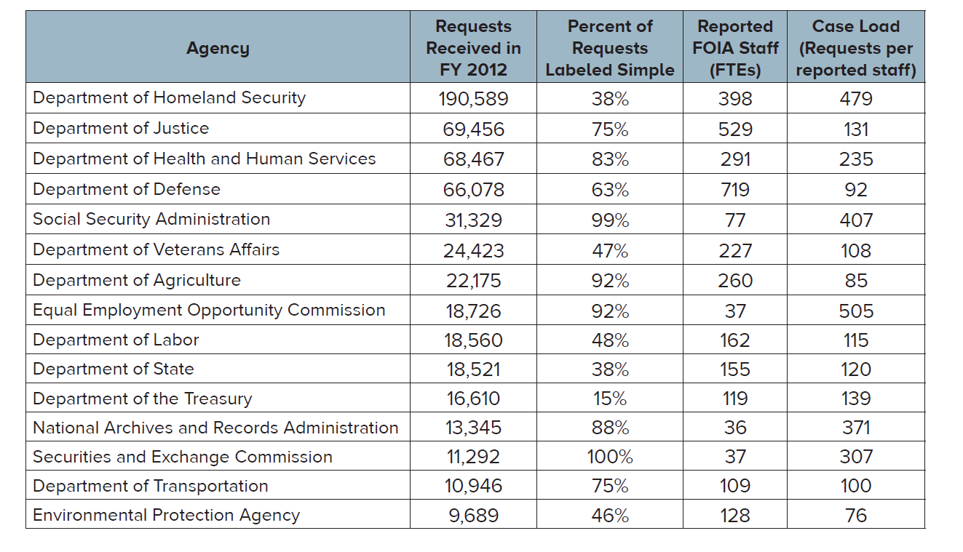
Reactive “whack-a-mole” FOIA burdens agencies.

Slide 9
Proactive Disclosure Subcommittee Challenges
Despite significant effort, we have not found a breakdown of any Federal agency’s FOIAs by type of record, type of request, or type of requestor
Can we obtain FOIA logs with sufficient description to identify type of record for each request?
Can we obtain actual requests to analyze? (We can from NRC, but it’s not representative.)
Would we need analysts to determine type of record for each request, or can we automate that?
Are there pilot agencies represented on the FOIA Committee who would be willing to pilot this with us?

Slide 10
Analysis of FOIL log from NY State Dept. of Environmental Conservation
55% of requests were for a few types of reports about particular addresses:
Spill incident reports
Petroleum storage reports
Soil and water remediation and inspection records
Air quality reports
Landfill reports
Frequent requestors said they would be very happy to get the data from web instead of requesting.

Slide 11
Example: Single Audit Act
Entity that receives $500,000 in Federal grants must send financial statement, management discussion, auditor’s opinion, and details of grants.
At least one company wants to use this information for rating municipal bonds.
In a test, all 4 reports FOIA’d were released unredacted, but required multiple follow-ups and 2 ½ months delay.
New OMB rules call for reports after 2014 to be posted on single Federal web site.
Submitters responsible for keeping PII out of reports.
Exemption for information restricted by Federal statute or regulation, but FOIA exemptions are not applied.

Slide 12
We’d like additional Committee members to work on Proactive Disclosure
Talk to us about what you’d like to do within your agency
Provide a pilot dataset for us from your agency
Help us with the cluster analysis

Slide 13
Thank You
David Reed
Eric Gillespie

