Slide 2
Briefing Outline
Overview of the CUI Program
Establishment of the Program
Elements of the CUI Executive Order
Requirements and Timelines
Categories and Registry
Handling CUI
Implementation Plan
Current Efforts

Slide 3
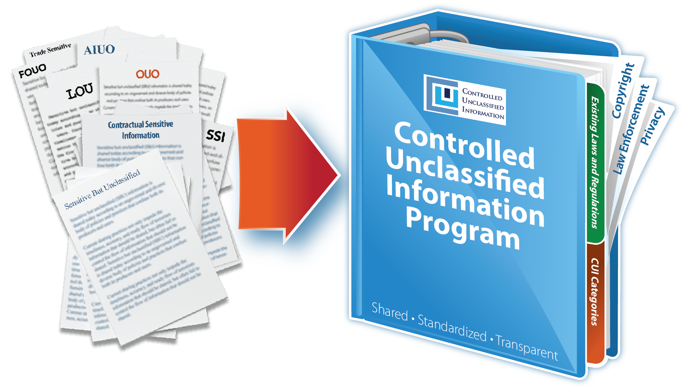
Overview of the CUI Program

Slide 4
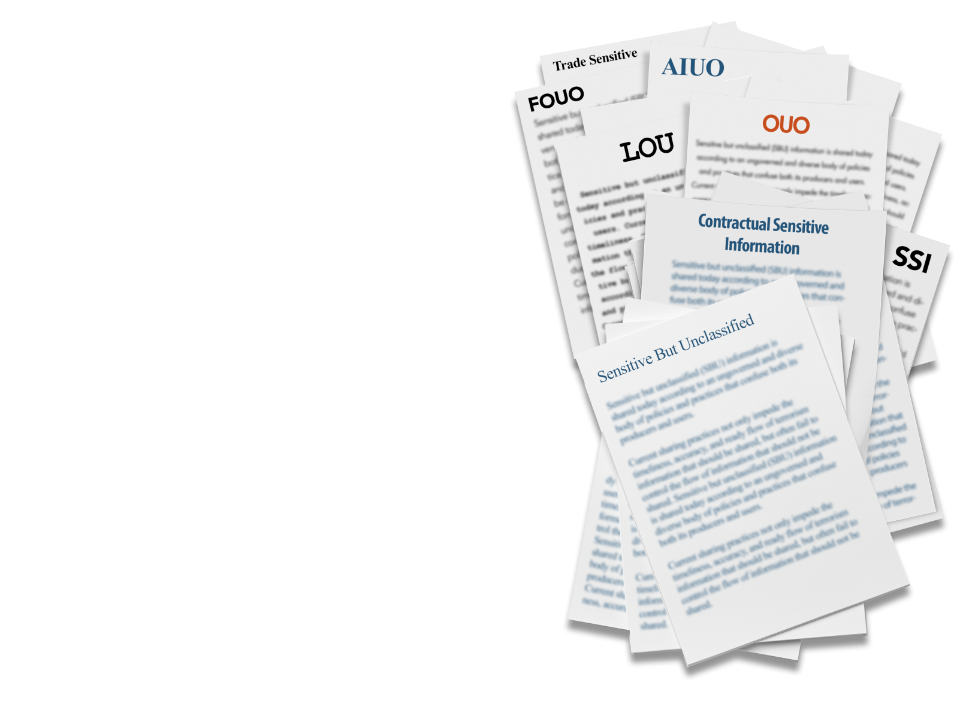
Why is the CUI Program necessary?
Executive departments and agencies apply their own ad-hoc policies and markings to unclassified information that requires safeguarding or dissemination controls, resulting in:
An inefficient patchwork system with more than 100 different policies and markings across the executive branch
Inconsistent marking and safeguarding of documents
Impediments to authorized information sharing
Unclear or unnecessarily restrictive dissemination policies

Slide 5
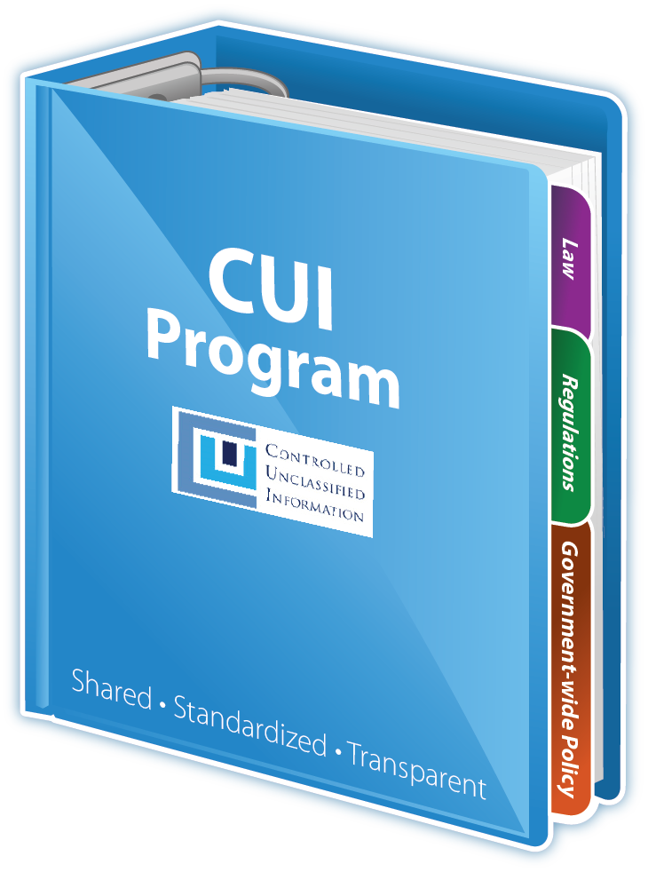
What are the benefits of the CUI Program?
One uniform, shared, and transparent system for safeguarding and disseminating CUI that:
Establishes common understanding of CUI control
Promotes information sharing
Clarifies difference between CUI controls and FOIA exemptions
Reinforces existing legislation and regulations

Slide 6
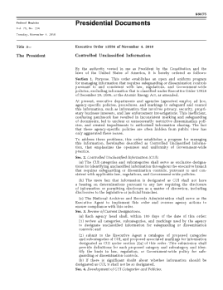
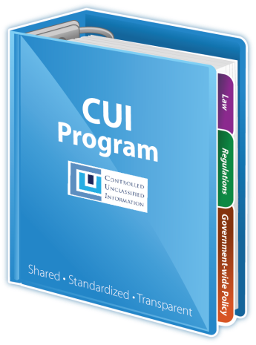
Executive Order 13556
Established CUI Program
Executive Agent (EA) to implement the E.O. and oversee department and agency actions to ensure compliance
An open and uniform program to manage all unclassified information within the executive branch that requires safeguarding and dissemination controls as required by law, regulation, and Government-wide policy

Slide 7
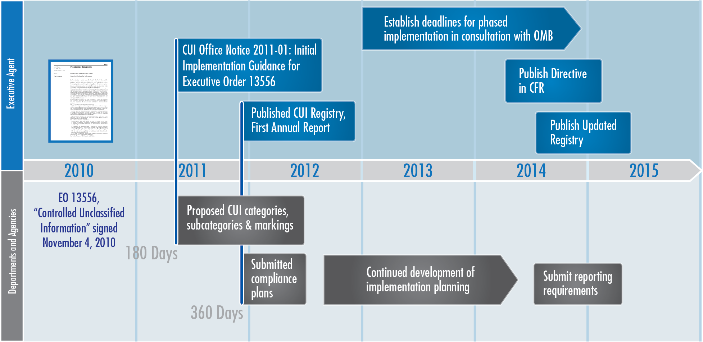
Implementation of Executive Order 13556

Slide 8
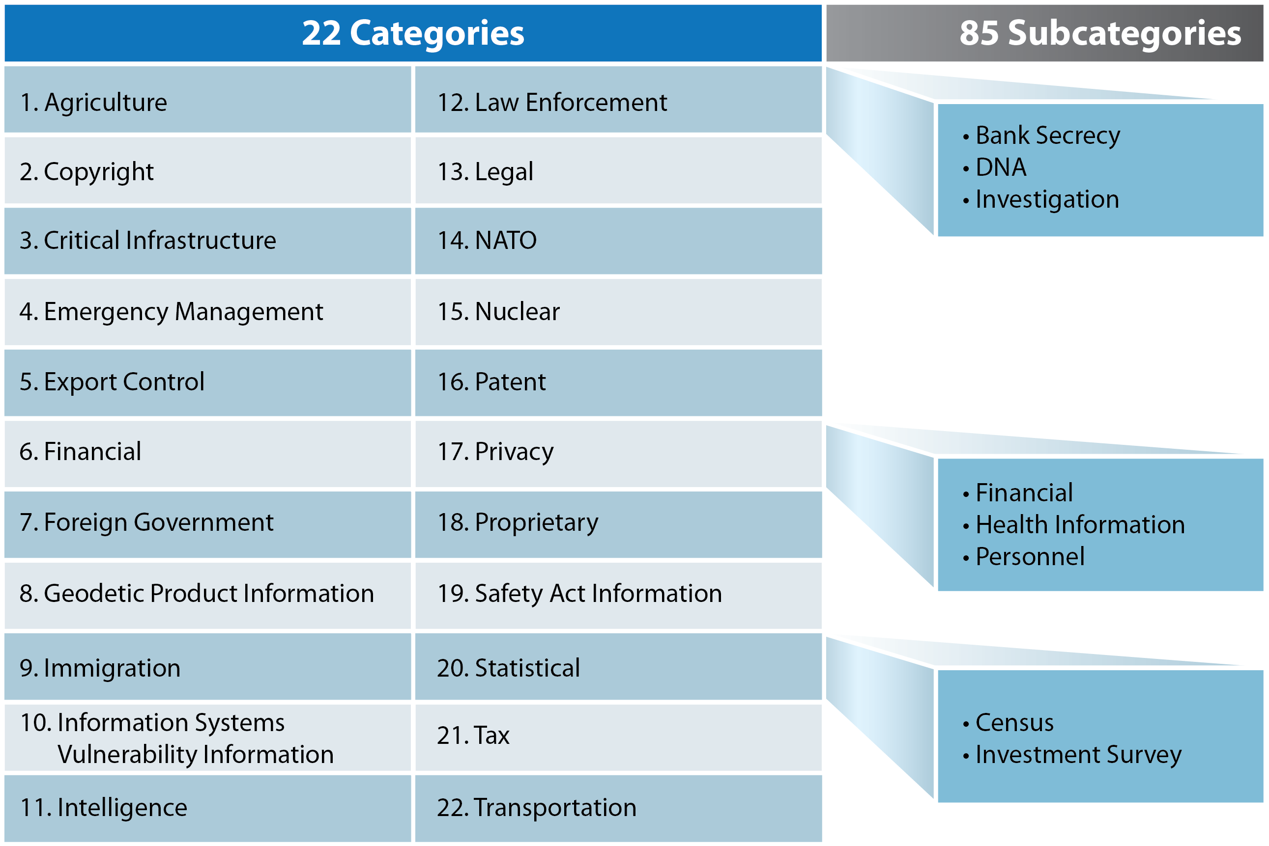
Approved CUI Categories

Slide 9
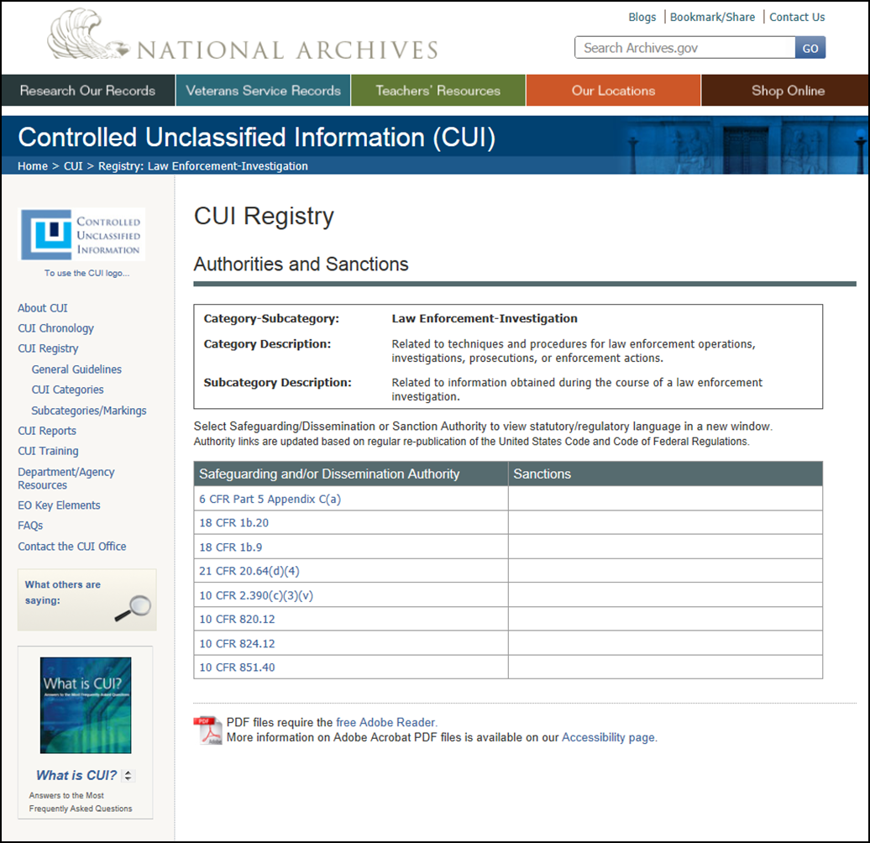
Online Registry
Notes:
the Registry is a work in progress, will be regularly updated;
a provisional approval process for new CUI categories is being developed.

Slide 10
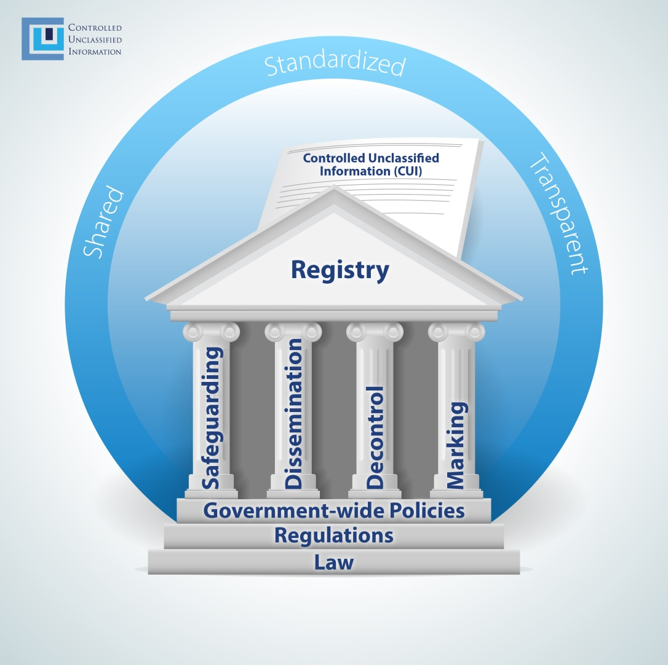
Handling CUI
One uniform and consistent policy applied to a defined and organized body of information

Slide 11
Five Programmatic Areas of Implementation Plan

Slide 12
CUI Executive Agent Current Efforts
Maintain Registry
Approve additional CUI categories and subcategories based on agency submissions
Provide guidance on provisional approval process for new CUI categories
Finalize CUI Policy
Complete draft through informal process
Submit through formal OMB comment process
Publish in CFR
National Implementation Plan (NIP)
With agencies, create and execute implementation planning framework, including deadlines for phased implementation

Slide 13
Questions?

Slide 14
Contact Information
Information Security Oversight Office
Attn: CUI Program
National Archives and Records Administration
700 Pennsylvania Avenue, N.W., Room 100
Washington, DC 20408-0001
(202) 357-6870 (voice)
(202) 357-6871/6872 (fax)
cui@nara.gov
www.archives.gov/cui

Slide 15
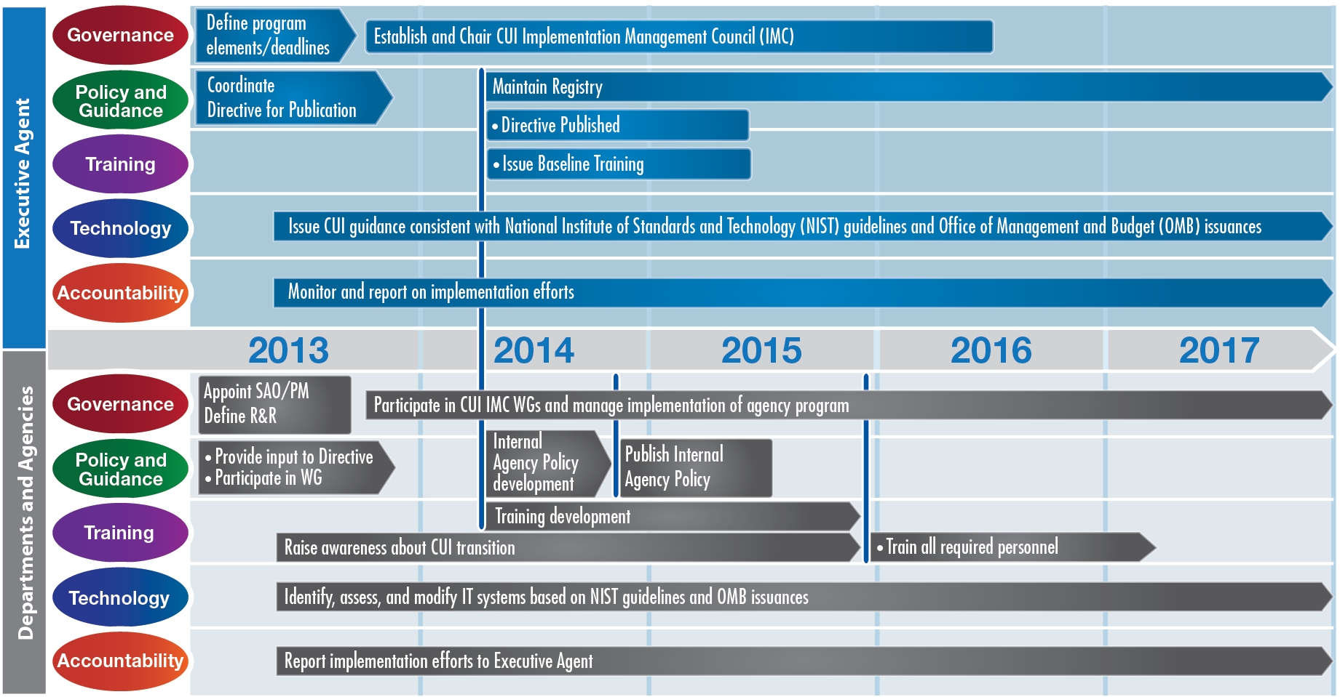
Notional Implementation Planning Framework

