Slide 1
NARA's Agency Services Bimonthly Records and Information Discussion Group (BRIDG)
Wednesday, April 16, 2014

Slide 2
Today’s Meeting Agenda
ARCIS Business Intelligence
Federal Records Officer Network Overview (FRON)
New Finding Aids Guidance Section
Managing Government Records Directive Update
New Additions to Records Express Blog
Overview of Email Management Guidance on Archives.gov

Slide 3
ARCIS Business Intelligence
John McEvoy, Manager of the ARCIS Team

Slide 4
What is ARCIS BI?
Intelligent Database.
Separate platform and server than ARCIS.
ARCIS BI database is re-created every night from ARCIS data via ETL script.
Database is made up of Data Cubes (Subject Areas) containing Dimensions & Columns that ultimately touch Data Points.
Example: Records Transfers (Cube) / Transfer Information (Dimension) / Records Transfer Number (Column) / PT-000-2014-1234 (Data Point).

Slide 5
Data Cubes

Slide 6
“Answers” Area

Slide 7
What Does ARCIS BI Do?
Provides better information that normal ARCIS queries. Much faster too.
Local or Enterprise Reporting.
Ad Hoc query and analysis
Dashboards – immediate operational information at our fingertips.
Predictive analytics.
Filtering and time sensitive analysis.

Slide 8
How ARCIS BI Helps FRCP Operations
Dashboards – immediate information / visualization
How is my FRC performing?
What are the outstanding transactions that need to be addressed?
What can I expect for disposal volume for the next cycle?
What are the trends for each transaction type?
Local or Enterprise levels
Helps FRCP operations improve by identifying problems.
Improves productivity.
Identifies data discrepancies in transfer information.
New analyses from scratch or modification of existing analyses.

Slide 9
Advantages for Our Customers
Improved customer service.
FRCP supervision – local and enterprise.
Fascinating reports in Excel.
Do not contact your Account Manager just yet…
Data integrity.
Confidence that we’re working to improve our operational processes and procedures through ARCIS data.

Slide 10
Other Items of Importance
Network of experts who QC query operatives and results prior to submission.
ARCIS BI Reports Library
Confidence in Reports.
Reduces dissemination of inaccurate data.
Control over proliferation and clutter in the BI environment.
We’ll get the reports to you, but please pardon the delay!

Slide 11
Lastly….
ARCIS Customer Portal Deployment!
Only 39 agencies on board thus far and we need you to sign up for a Gateway 1 meeting (demo and discussion) to begin planning your deployment strategy.
User Administration, Access Controls, Records Transfers, Reference Requests.
john.mcevoy@nara.gov

Slide 12
Questions and Answers
Thank you!
For more information, please contact:
John McEvoy
240-338-3616 (cell)
john.mcevoy@nara.gov

Slide 13
Federal Records Officers Network Overview (FRON)
FRON Co-Chairs, Wendy Couch, Department of Commerce, and Ron Swecker, Department of Transportation

Slide 14
Agenda
Purpose of FRON
Background on why/how the group was formed
FRON Collaboration Opportunities
Questions?

Slide 15
Purpose of FRON
We are a network of Records Officers that address RM Programmatic issues that exist across Federal agencies. The main goals are to:
Share experiences
Leverage best practices, tools, and templates
Leverage the collective efforts to address common issues

Slide 16
Background
Small meeting around interest in coordinating training
Idea of FRON developed
FRON goes virtual with MAX collaboration site
FRON goes face-to-face with first formal meeting
FRON serves over 110 members in 40 Federal agencies
April 2014
June 2013
May 2013
Early 2013
Fall 2012
Notes:
*Open to all Federal Records Officers and those actively involved in the advancement of records & information management
*Not limited by size of the agency

Slide 17
FRON Membership
Open to all Federal Records Officers and those actively involved in the advancement of records & information management
Not limited by size of the agency

Slide 18
Collaboration Opportunities
Virtual Networking
Face-To-Face Networking
Online experience is first choice for some users
Face-to-face is first choice for some users
Online conversations for short immediate answers
More depth to conversations
Inclusive for those who cannot travel to meetings
Downloadable document sharing
Encourage rotating hosting to expand participation
Blended Experience
Outlet for Centers of Excellence to Share

Slide 19
FRON Monthly Meetings
Hosted by a different agency each month
In-depth discussions of hot topics
Ongoing efforts are discussed
New topics are introduced
FRON way-forward

Slide 20
Topics Being Explored
All members have input on scheduling and priority of the topics:
Core competencies for a records & information office/organization
Common RM training across the Federal government
RIM Strategic Planning
Records & Information Management (RIM) requirements for electronic systems (not electronic records management systems)
Training plans
RM strategic plans
Policies, tools and templates
Use of SharePoint for managing records
Where should RIM be assigned within an organization?

Slide 21
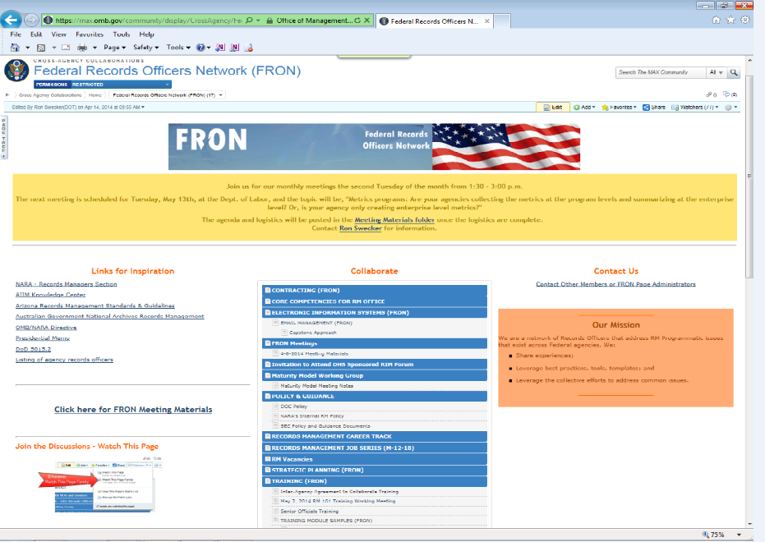
OMB MAX Collaboration Site

Slide 22
FRON Site Capabilities
Online Discussions
Repository of policies, tools, and templates for sharing
Listing of RIM-related events
Meeting materials
Network with the Federal RIM community

Slide 23
FRON Core Team
Ron Swecker, Dept. of Transportation
ron.swecker@dot.gov
(202) 366-2475
Wendy Couch, Dept. of Commerce
wcouch@doc.gov
(202) 482-4559
Maj Karlyn Slaydon, National Guard Bureau
karlyn.k.slaydon.mil@mail.mil
(703) 607-0764
Join us for our monthly meetings the second Tuesday of the month.

Slide 24
Questions?

Slide 25
New Finding Aids Guidance Section
Tim Enas, Chief, Textual Accessioning

Slide 28
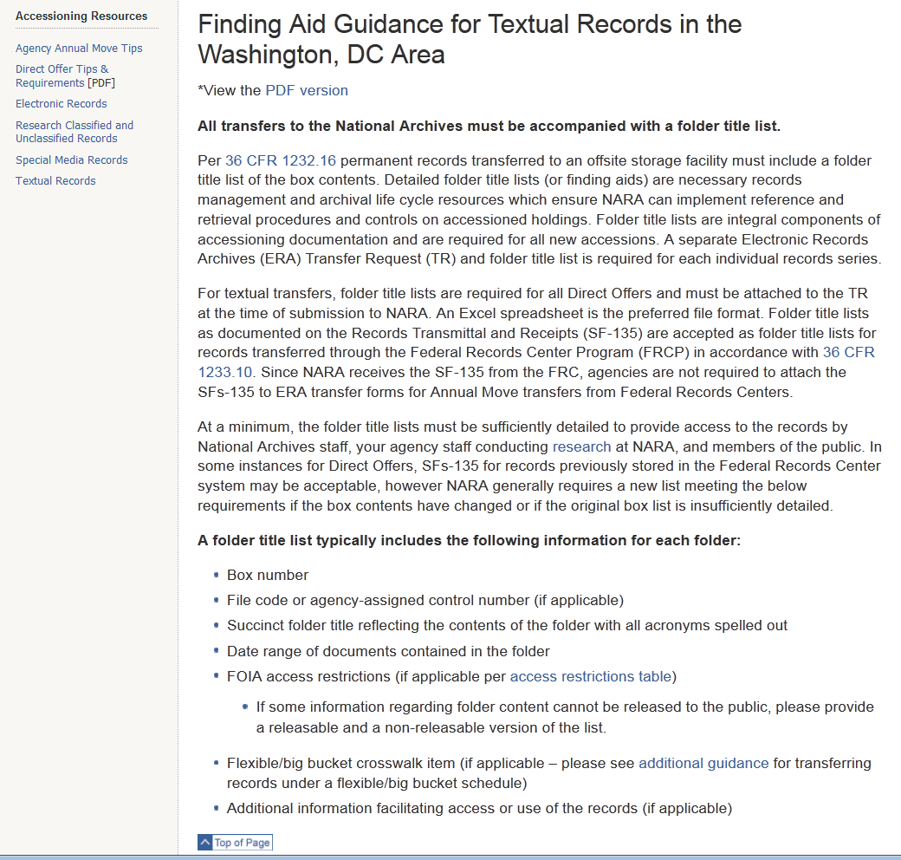

Slide 30
Folder title list

Slide 31
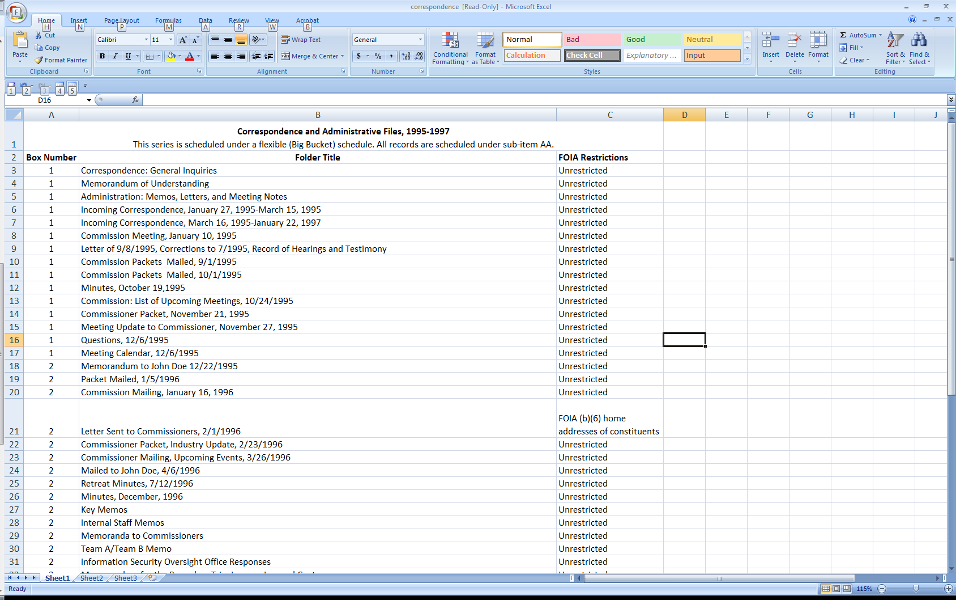
Folder title list with references to access restrictions and flexible schedule crosswalk information

Slide 32
Box list

Slide 33
Managing Government Records Directive Update
Don Rosen, Director, Policy Analysis and Enforcement, NARA

Slide 34
Overview
Goal A3.1: what we’re trying to accomplish
Resources already available for agencies
A3.1 Deliverable Report and Plan
Get involved!
Q&A

Slide 35
Goal A3.1
Investigate and stimulate applied research in automated technologies to reduce the burden of records management responsibilities
NARA, the Federal Chief Information Officers Council and the Federal Records Council will work with private industry and other stakeholders to produce economically viable automated records management solutions. By December 31 , 2013, NARA will produce a comprehensive plan in collaboration with its stakeholders to describe suitable approaches for the automated management of email, social media, and other types of digital record content, including advanced search techniques. The plan will detail expected outcomes and outline potential associated risks.

Slide 36
Resources for Agencies
Industry Day and RFI in early September - Result:
Almost 50 vendor submissions describing tools and services for automation of electronic records management
Available to anyone with .gov or .mil email account on OMB MAX ERM Automation wiki
https://max.omb.gov/community/x/5QlfJw
Use them! They’re there for you.
Notes:
Leading up to the Development of this Report, we set up several platforms to get feedback and community enagement
ERM Automation Wiki
Vendor Day
Capability Statements

Slide 37
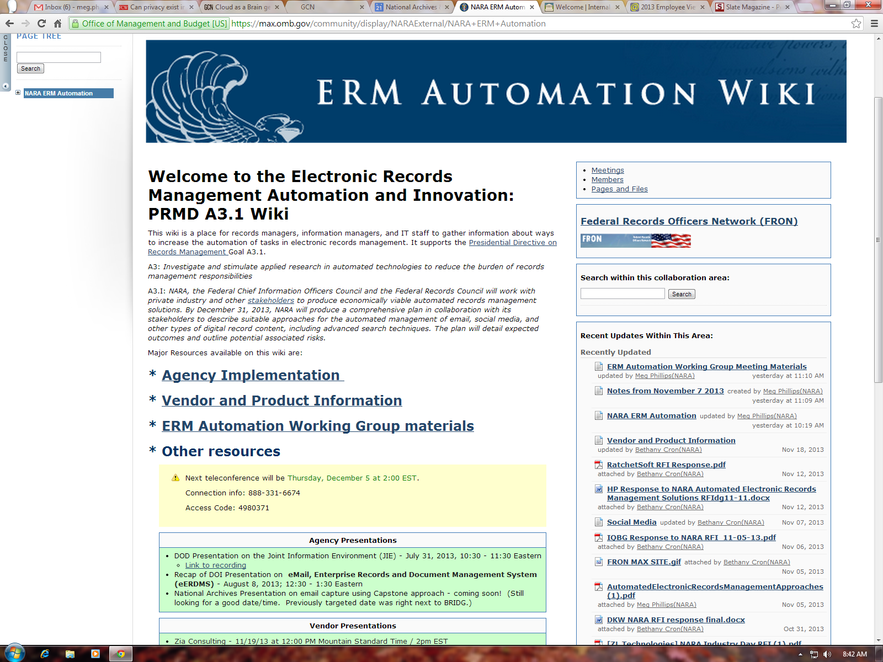

Slide 38
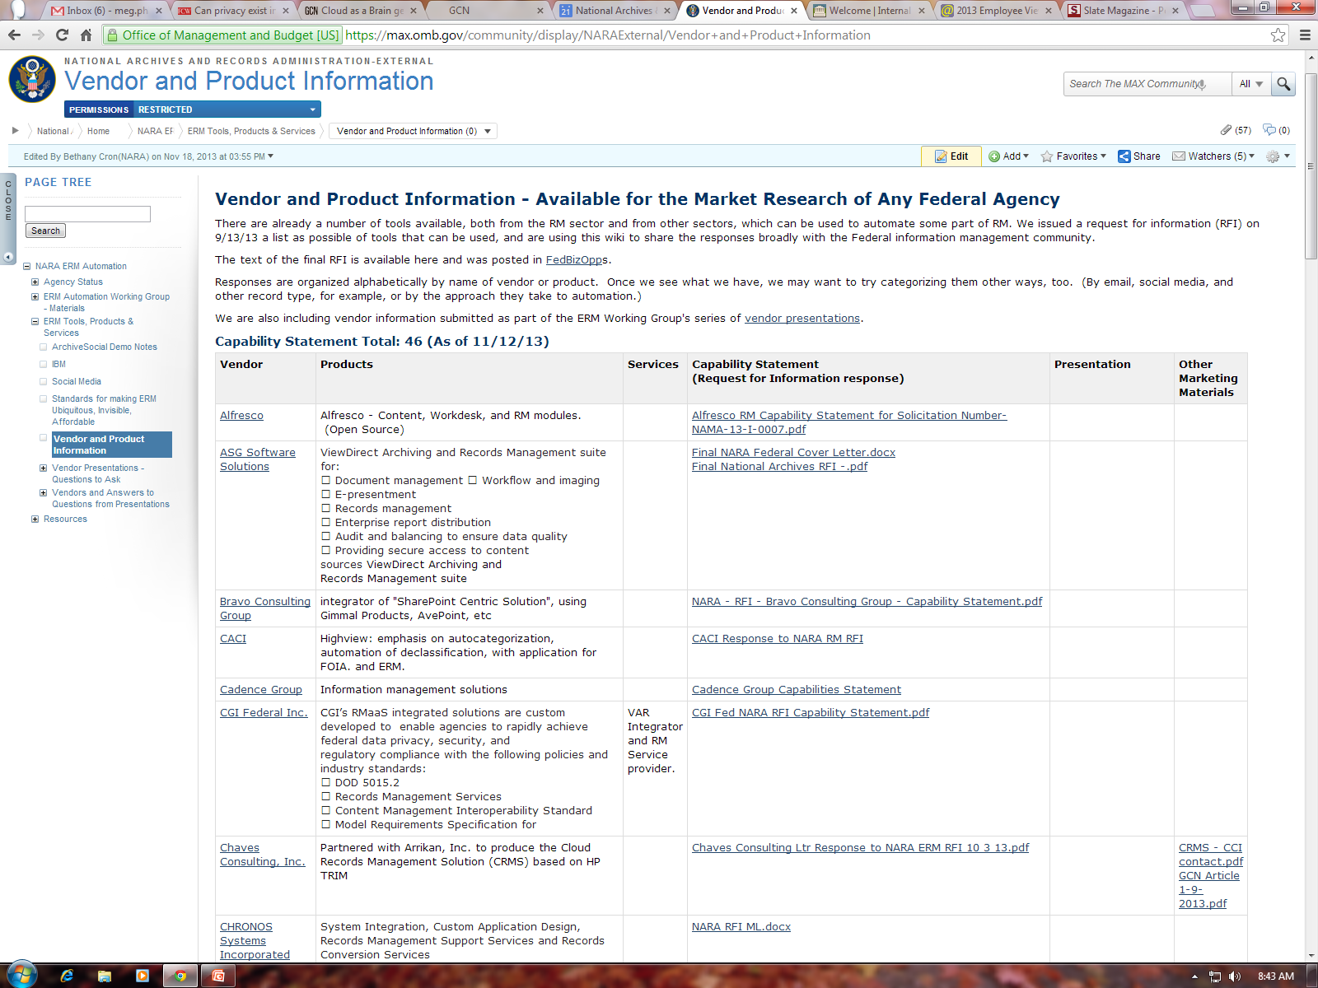

Slide 39
A3.1 Report and Plan
Draft report/plan was posted for input on Records Express March 10:
http://blogs.archives.gov/records-express/2014/03/10/comment-and-discuss-the-automated-electronic-records-management-report-and-plan/
Comments due 4/25/14
Approaches to Automation
No Automation
Rule Based Automation
Business Process and Workflow Automation
Modular, Re-usable ERM Tools
Autocategorization
Discusses outcomes, benefits, and risks
Plan: exploring a variety of ways to make those approaches more accessible and affordable for agencies
Notes:
We, with significant assistance from the Electronic Records Management Automation Working Group, have completed a draft report and plan to satisfy Managing Government Record Directive Goal A3.1. This draft is available here (.pdf) for your review, suggestions, and discussion.
We decided that it would be most useful to satisfy the goal by drafting two things, a report and a plan.
The report addresses categories of suitable approaches for automating ERM and discusses their outcomes, benefits, and risks. Our goal is to finalize the report in June 2014, incorporating the comments you send now.
The report covers the goals of electronic records automation, what the project has accomplished to date, and a framework of 5 suitable approaches to automation that the Federal government can pursue.
No automation at all – technically not required. I.e. Shared Drives. Risks of this approach – relying on perfect execution.
Rule Based Automation –
Business Process and Workflow Automation – Baking RM into the Process/Business System
Modular Reusable RM Tools – A catch all. One of the ways would be RM Services. FEA. Build into the infrastructure. Other models talk about having an App Store or Services. Plug them in. Get from a catalog. I think there is a lot of promise there
Content Analysis – Advanced Search Tools. Could be a powerful way of automating RM. This works for unstructured material. Could be. Most highly developed in the e-discovery space. Lot of power in these autocategory systems.
Second Part is Plan outline goals for 2014- 2019

Slide 40
Get Involved
Participate in the ERM Automation Working Group:
Contact PRMD@nara.gov or Meg.phillips@nara.gov to join the distribution list
Use vendor info on the A3.1 ERM Automation wiki:
https://max.omb.gov/community/x/5QlfJw
Plan an automated approach using vendor demos and wiki resources
Pilot an automated approach and share lessons learned with the community
Help NARA refine the A3.1 Plan, and then help execute the plan!

Slide 41
Comment on Plan
Comment on high-level issues right on the blog so we can have a discussion
What should the long term future look like to achieve vastly improved access to government information?
What steps could we take to get there?
Are there points (in the report or plan) that need clarification?
Are these the right goals, initiatives, and tasks ?
Are there missing goals, initiatives, or tasks? Who could do them?
What stakeholders would need to be consulted? What stakeholders are already working in these areas that we should coordinate with?
Are you in a good position to help with any of the tasks?

Slide 42
Contact Information
All updates can be found on
the Records Express Blog http://blogs.archives.gov/records-express/
General questions
PRMD@nara.gov
Contact information
Donald.Rosen@nara.gov

Slide 43
Managing Records in a Mobile Environment on Records Express
Lisa Haralampus, Supervisor, Records Management Policy Team, NARA

Slide 44
Post #1:
What do you think about the increased use of mobility in the Federal government?
Is this a trend you see in your agency?

Slide 45
Post #2:
Have you seen these mobile risks?
Are there any risks we’ve missed?

Slide 46
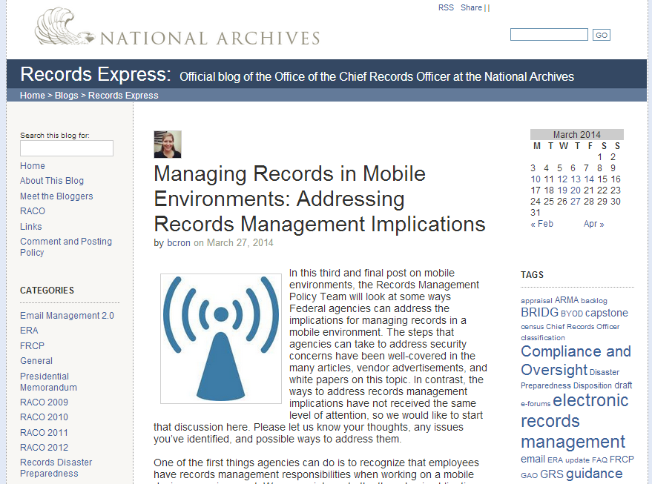
Post #3:
What do you think about the increased use of mobility in the Federal government?
Is this a trend you see in your agency?

Slide 47
Join the Discussion!
Comment on the blog
Send me your feedback:
Lisa.Haralampus@nara.gov

Slide 48
Overview of Email Management Guidance on Archives.gov
Margaret Hawkins, Director, Records Management Services, NARA

Slide 49
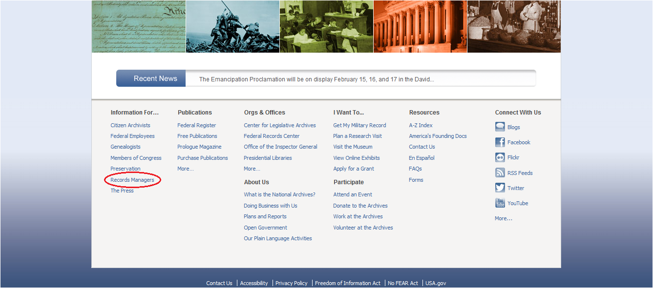
www.archives.gov
Notes:
On our website … www.archives.gov … the best link for records management professionals in the Federal government is called “Records Managers” ….

Slide 50
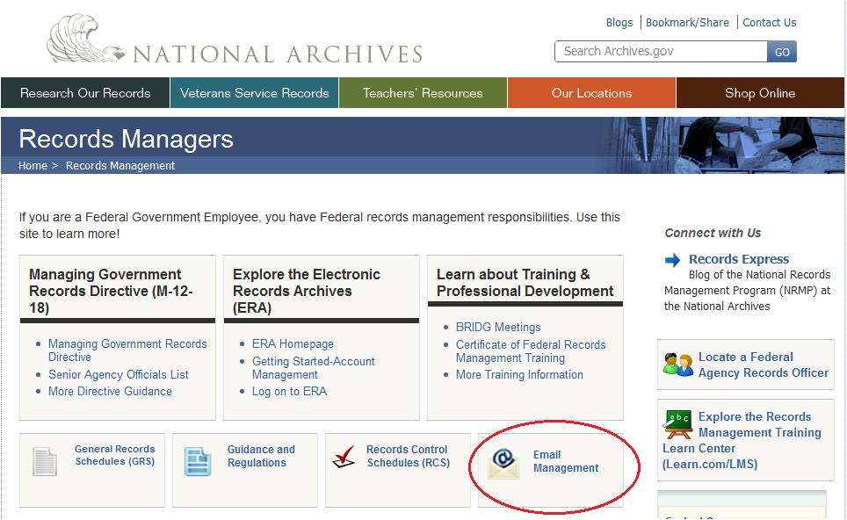
Notes:
Which brings you to a wealth of information on records management in the Federal government. One of the links offered is for “Email Management,” which is where the resources and tools related to Capstone may be found.

Slide 51
Notes:
Point out that a new layout is expected this week, especially with the increase in resources being added to this page.

Slide 52
Existing Tools and Resources:
Recording of General Capstone Training, and related handouts
Recording of Question & Answer Panel
Recording of a Presentation on NARA’s Own Implementation of Capstone
NARA’s draft records disposition schedule (pending approval)
Links to Related Material/Guidance
Notes:
The following content has been available on our website for a few months now:
General Capstone Training
-In late 2013, five sessions were offered on the Capstone approach. This video has multiple sections with general information on Capstone:
1) the bulletin itself, 2) how to get started, 3) who should be
involved, 4) legal considerations, 5) Capstone scope, 6) designation of Capstone accounts, and 7) scheduling and disposition.
-Our website includes a recording of one of these sessions.
-Also included are materials related to this session: the slide-deck, all related handouts, and a “Capstone Planning Checklist”
Question and Answer Panels
-In early 2014, two panel discussions were held, where email experts from the National Archives answered questions related to Capstone --and email management in general. Panelists included representatives from NARA’s appraisal staff, legal counsel, formats, policy, and records transfer.
-Our website includes a recording of one of these panel sessions.
Presentation of NARA’s Own Implementation of Capstone
-NARA has implemented a Capstone approach for the management of NARA’s own email.
-NARA’s Records Officer, Susan Sullivan, presented on NARA’s implementation of Capstone on 2/4/2014. This session includes information on how NARA got started, who was involved, implementation factors, and what was needed to ensure staff were informed of the new policies.
-Our website includes a recording of this session.
Also included are links to other email-related guidance issued by NARA. The Bulletin itself answers many questions about Capstone, and may be the best place to start. Capstone supports the Managing Government Records Directive, which specifically requires that email be managed in an electronic format by the end of 2016 (section 1.2). Other links include one to NARA’s recently issued transfer guidance, which includes a section regarding the transfer of permanent email records.
The rest of the resources I will be talking about are new to the webpage.

Slide 53
Targeted Capstone Briefings (new):
Managers’ Briefing: a short recording by Chief Records Officer Paul Wester, focused on what managers need to know about Capstone.
Legal Briefing: a short recording by Hannah Bergman, Assistant General Counsel, focused on what agency legal staff need to know about Capstone.
Notes:
These short briefing videos are each about 10 minutes, and aimed at specific target audiences … audiences that need to understand and may need to be active stakeholders if an agency wishes to implement Capstone.

Slide 54
Technical Resources (new):
In March of 2014, NARA’s Records Officer presented Capstone Email Management Implementation: Technical Perspective, to discuss the more technical aspects of NARA’s approach. Our website includes a recording of this session.
Technical Functionality to Support Capstone: Planning Checklist: a checklist to assist agencies in determining if their existing or planned technology has the functionality to support a Capstone approach.

Slide 55
Other Resources (new):
Documents related to NARA’s implementation of Capstone:
Sample Statement of Work
Sample Capstone Policy Guidance
Sample Agency Issued FAQ on Email Management
Sample User Guide for Managing Email
Sample Email Management Configuration
Sample Quick Guide: Email Setup & Configuration
Notes:
Most of these are new additions to our online resources. Since NARA was one of the first Federal agencies to implement Capstone, we are sharing many of our procurement and implementation documents, which may be considered samples for other agencies.

Slide 56
Coming Soon:
Sample Capstone Records Disposition Schedules, as they become approved.
Recordings of agency-lead discussions on Capstone, including topics such as account designation, lessons learned, implementation, training, etc.
Notes:
NARA will be adding additional resources, including approved records disposition schedules. A few agencies have already submitted --- once approved they may be used as samples/models for other agencies to follow. We also hope to work with other Federal agencies who have been planning for Capstone, and get them to present on their process and share their lessons learned.

Slide 57
Questions?
Notes:
You may also contact your NARA Appraisal Archivist with any questions …

Slide 58
FY14 BRIDG Meeting Dates
Wednesday, June 18, 2014 Meet and Greet for Appraisal Team 3 Group
Wednesday, August 6, 2014 Meet and Greet for Appraisal Teams 2 and Team 4

