Slide 1
NARA’s Regulation for Digitizing Permanent Records
Wednesday, June 7, 2023
Agency Webinar

Slide 2
Welcome and Introductions!
Lisa Haralampus, Director, Records Management Policy and Outreach
John Martinez, Supervisor,
Policy and Standards
Kevin De Vorsey, Senior Electronic Records Policy Analyst

Slide 3
Guidance Impacting Approach
Nov 2014: Federal Records Act Amendments
Feb 2018: NARA Strategic Plan (updated 2022)
Jun 2019: OMB/NARA Memo M-19-21
Dec 2022: OMB/NARA Memo M-23-07
“The Archivist shall promulgate regulations establishing . . . standards for the reproduction of records by photographic, microphotographic, or digital processes with a view to the disposal of the original records.” - FRA
“NARA will issue updated regulations and clear policies that permit agencies to digitize records created in analog formats and, where appropriate, dispose of analog originals.” - M-23-07

Slide 4
Review Process
Apr 2019: Digitization regulation for temporary records published as a final rule
May 2020: Draft digitization regulation for permanent records sent for review to agencies
Dec 2020: Draft digitization regulation for permanent records published for public comment
Sep 2022: Draft digitization regulation for permanent sent for review to select agencies
Feb 2023: Draft digitization regulation for permanent sent for review to select agencies
review to select agencies
May 4, 2023: Published as a final rule
June 5, 2023: Digitization regulation goes into effect

Slide 5
Other items in Final Rule
36 CFR Subpart F -- Transfer Metadata
When agencies transfer permanent records to the National Archives’ legal and physical custody, the agency must provide transfer metadata to NARA. The transfer metadata must be entered into the Electronic Records Archives (ERA) when the Transfer Request (TR) is created to begin transferring the records. Each transfer of digital records must include the following metadata that applies to the transfer as a whole.
36 CFR 1225.22(a)
Every five years, agencies must review all records schedules that are ten years old and older, based on the date that NARA approved the schedule. Agencies may also review their agency records schedules on a more frequent regular basis to determine if they remain accurate.

Slide 6
Digitization Standards for
Temporary Records
36 CFR Subpart D -- Digitizing Temporary Federal Records
§ 1236.30 Requirements for digitizing temporary records.
§ 1236.32 Digitization standards.
§ 1236.34 Validating digitization.
§ 1236.36 Disposing of original source records.

Slide 7
Digitization Standards for
Permanent Records
36 CFR Subpart E -- Digitizing Permanent Federal Records
1236.40 Scope of this subpart
1236.41 Definitions for this subpart
1236.42 Records management requirements
1236.44 Documenting digitization projects
1236.46 Quality management requirements
1236.48 File format requirements
1236.50 Digitization requirements for permanent paper and photographic prints
1236.52 Digitization requirements for permanent mixed-media files
1236.54 Metadata requirements
1236.56 Validating digitized records and disposition authorities

Slide 8
36 CFR 1236.40
Scope
Scope of this Subpart:
This regulation applies to records that can be scanned using reflective techniques, such as:
Paper records (all sizes and types)
Printed photographs
Mixed Media Records
But not materials that are scanned using transmissive or other techniques, such as:
Photographic negatives
Motion picture film
Microforms
A/V records

Slide 9
36 CFR 1236.42
Records Management
Records Management Requirements:
Establish intellectual control.
Records must be prepared, indexed, maintained in their original order.
Survey source records for preservation problems and select equipment that safely digitizes originals.
Identify the age, media types, dimensions, required level of detail, and condition of source records prior to digitization.

Slide 10
36 CFR 1236.44
Documentation
Documentation Requirements:
You must implement a program that digitizes records to the parameters in the regulation
You must create the following documents when digitizing permanent records and retain them in association with the digitized records:
A defined project plan
Quality management plans describing quality assurance (QA) objectives that achieve the requirements
Quality control (QC) procedures
Documentation is retained by agencies, not transferred to NARA

Slide 11
36 CFR 1236.46
Quality Management
Quality Management Requirements:
Monitor and quantify scanner performance
Identify and correct errors due to:
Malfunctioning or improperly configured digitization equipment
Improper software application settings
Incorrect metadata capture
Human error
Regularly execute QC inspections of files for compliance with all parameters.

Slide 12
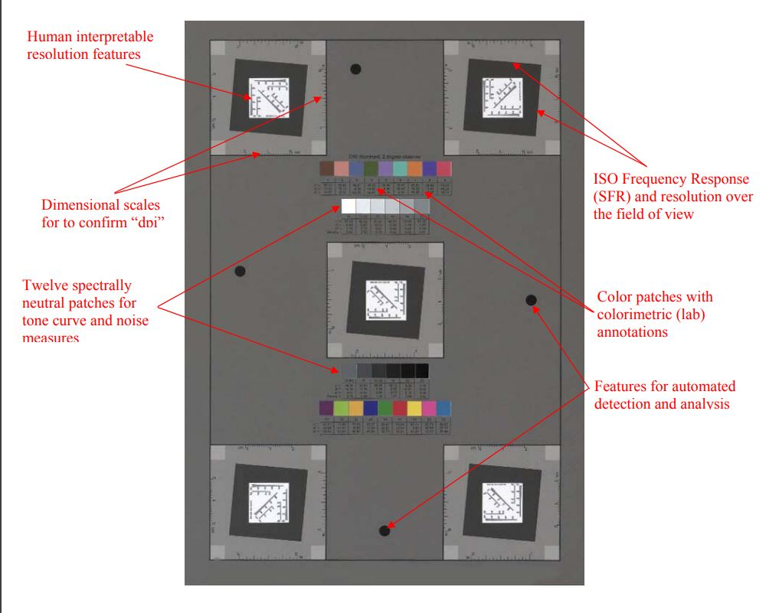
Federal Agencies Digital Guidelines Initiative (FADGI)
Federal Agencies Digital Guidelines Initiative (FADGI)
Digital Image Conformance Evaluation (DICE)

Slide 13
36 CFR 1236.48
File Formats
File Format Requirements:
Image data must be uncompressed or use one of the following visually lossless compression methods:
Uncompressed
Deflate (Zip)
JPEG 2000 part 1 core coding system lossless compression. (Agencies may use up to 20:1 visually lossless compression)
Digital files for Textual and photographic print records must be encoded in the following formats:
TIFF
JPEG 2000
PNG
PDF/A (any version as long as the attachments feature is not used)

Slide 14
36 CFR 1236.50
Digitization Requirements
Digitization Requirements for Permanent Paper and Photographic Print Records:
The regulation has two major imaging specifications: Permanent paper and Prints and Photographs
Equipment must be appropriate for media type, capable of meeting project requirements, and the imaging parameters
Implement quality analysis using reference targets to verify conformance to imaging parameters
Regularly test equipment to ensure they are operating optimally, at beginning of workday, start of each batch, or when problems are detected

Slide 15
36 CFR 1236.52
Mixed Media
Digitization Requirements for Permanent Mixed-Media Files:
Identify the contents of any electronic or analog storage media
Determine whether any files on the storage media are records
If the files are records, determine whether they are components of mixed-media files that are being digitized.
If they are permanent records not associated with the rest of the records in the file migrate them to an electronic information system

Slide 16
36 CFR 1236.54
Metadata
Metadata Requirements:
Capture administrative metadata, including the source record’s disposition and item number
Capture descriptive metadata from source records at the record level
Capture descriptive rights and restrictions metadata from source records at the record level, to document any that relate to the records
Generate and capture technical metadata
Generate checksums when digitization is complete
Capture technical metadata describing the digitization process and resulting electronic records

Slide 17
36 CFR 1236.56
Validation
Validating Digitized Records and Disposition Authorities
Ensure that digitized records meet all image quality, metadata, and records management requirements
A separate step from quality management
Ensure that the digitized records are complete and accurate, and can meet the same business needs as the originals
Agencies should consult with their General Counsel to ensure that their validation process is sufficient

Slide 18
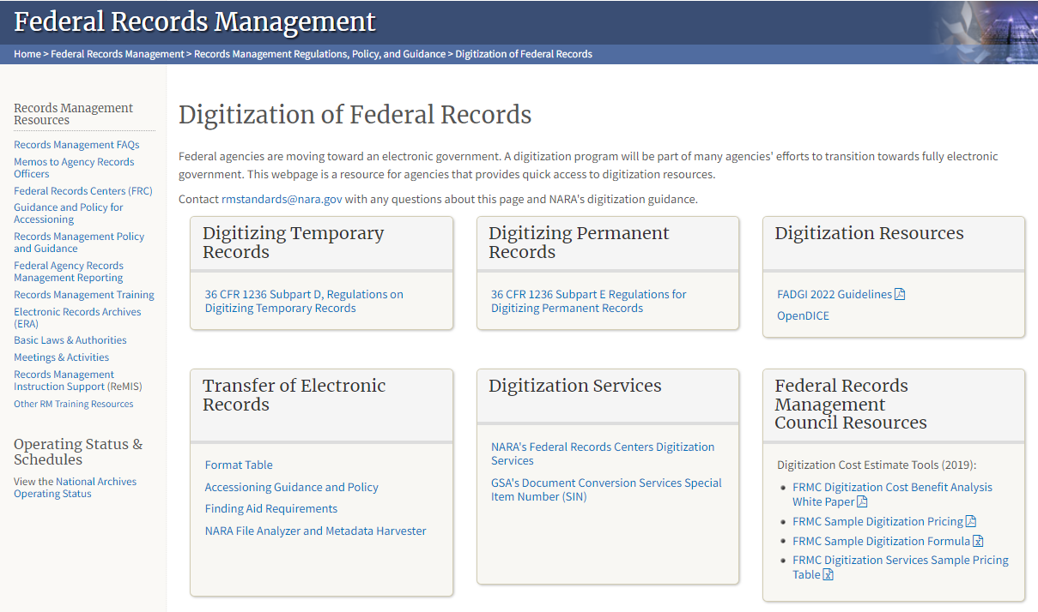
https://www.archives.gov/records-mgmt/policy/digitization

Slide 19
Additional Products
We are issuing a series of blog posts on Records Express with more discussion about digitization.
We are issuing a new GRS 4.5 and revising existing GRS 5.2
We are continuing to develop additional guidance products and resources over the next several months.
We are also working on digitization standards for film records. The current plans are to incorporate these standards into the existing regulation.

Slide 20
Questions?
Seventh and eighth grade class in Westley, CA school after lesson in geography. National Archives Identifier: 148741583.

