Slide 1
NARA’s Digitization Regulations Michael Horsley Electronic Records Policy Analyst Records Management and Policy Team Office of the Chief Records Officer
Notes:
Thank you John, I am Michael Horsley. Thank you for inviting me to talk about NARA’s digitization regulations for federal agencies. honored to be here Jeff and kevin I am an Electronic Records Policy Analyst with the Records Management and Policy Team in Agency Service’s Office of the Chief Records Officer. I served on the preservation team for the Smithsonian Institution Archives, a photographer for the conservation division at the library of congress, a digitization specialist in NARA’s digital imaging lab, I formerly served as a Team Lead in NARA’s corporate records management, and currently I am a policy analyst in the CRO’s office where I am responsible for developing the technical standards for NARA’s digitization regulations. I am a technical editor for the latest Federal Agency Digital Guideline Initiative’s (Known as FADGI) May 2023 “Technical Guidelines for Digitizing Cultural Heritage Materials” Third Edition. Where I authored a digitization code of ethics modeled after similar codes found in American Institute for conservation and the Society of American Archivists codes of practice, as well as developing standards for mass digitization of modern office paper documents.

Slide 2
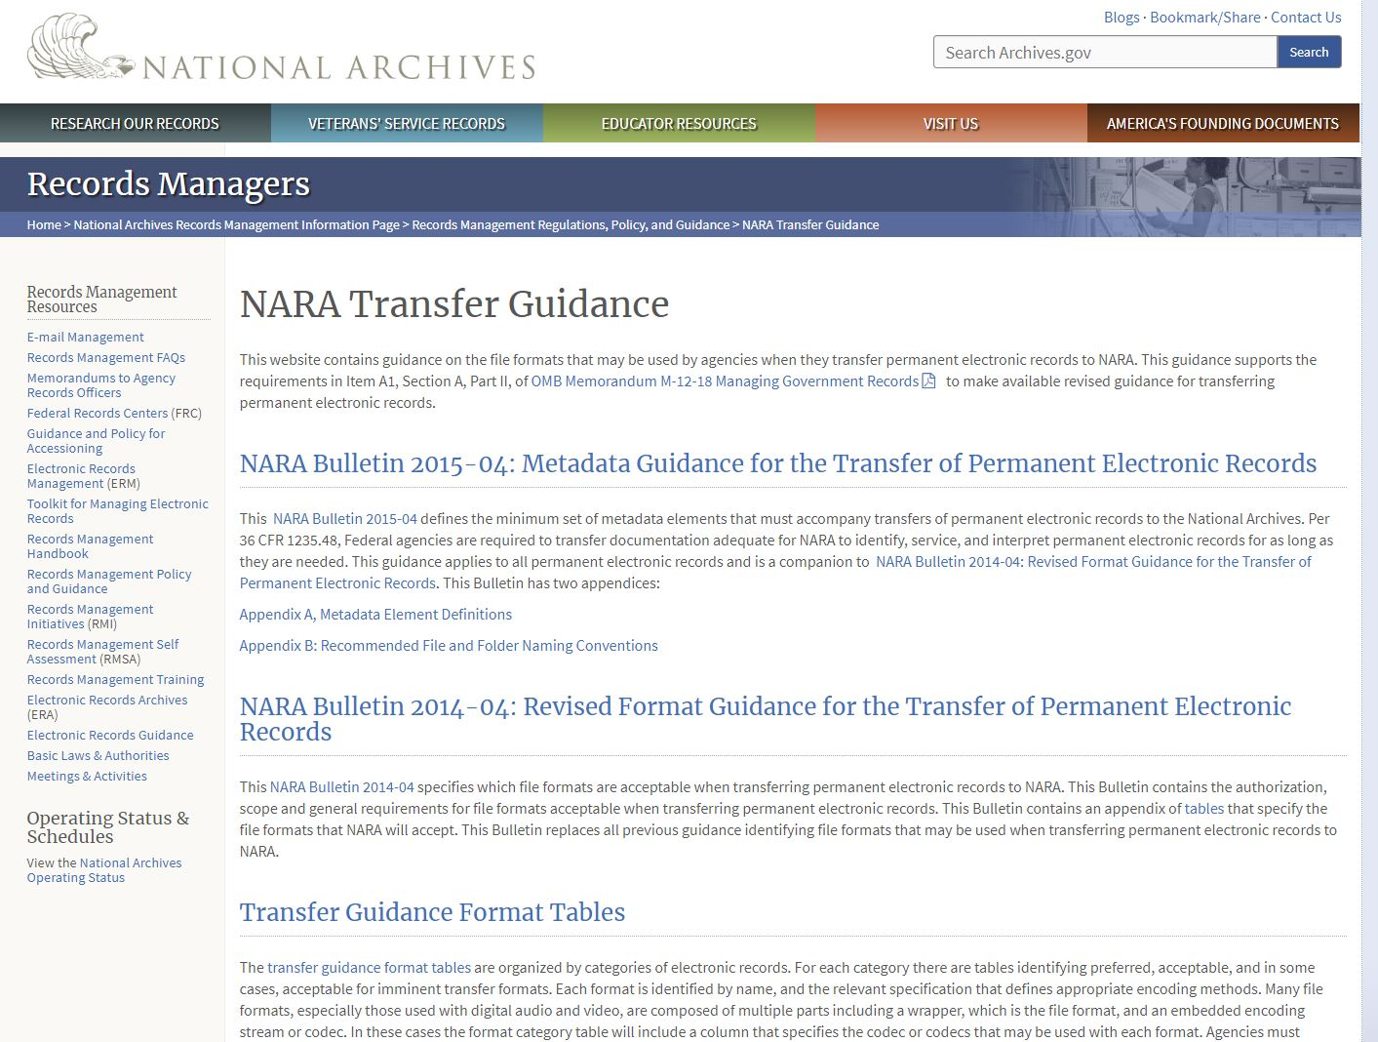
What do we do?
Notes:
The Office of chief records officer provides guidance products to support federal agencies in achieving their records management responsibilities
We issue Bulletins which articulate NARA’s records management policy
Maintain regulations related to records management
Publish FAQs and other products to clarify records management issues and responsibilities for agencies
Key records management guidance maintained by the team are: “2015-04: Metadata Guidance for the Transfer of Permanent Electronic Records” , and
“2014-04: Revised Format Guidance for the Transfer of Permanent Electronic Records”

Slide 3
Digitization Regulations for Permanent and Temporary Records
36 CFR Part 1236 - ELECTRONIC RECORDS MANAGEMENT-Subpart E- Digitizing Permanent Federal Records
36 CFR Part 1236 Subpart D - Digitizing Temporary Federal Records
Adopts the technical standards found in ISO 19264-1:2021 Photography — Archiving systems — Imaging systems quality analysis — Part 1: Reflective originals
Endorses the FADGI, Technical Guidelines for Digitizing Cultural Heritage Materials method for analyzing digital imaging performance in conformance to ISO 19264
Notes:
The regulation describes the standards and procedures that must be applied when digitizing permanent records using reflective digitization techniques. Such records include paper documents, prints, bound volumes, photographic prints, and mixed-media records. The current regulation does not apply to photographic negatives, transparencies, aerial film, roll film, micrographic, or radiographic materials that must be digitized using transmissive digitization techniques, or dynamic media, including motion picture and audio-visual records.
The digitization subpart is structured to include mandatory and recommended requirements such as:
Records Preparation
Documentation requirements
File format requirements
Digitization requirements for permanent paper and photographic print records
Digitization of permanent mixed-media files
Quality control inspection requirements
Validating digitized records and disposition instructions
The vast majority of federal records are temporary. We requirements are purposely open ended to allow agency’s freedom to choose the most practical approach to meeting their needs. The main requirement is that you are able to use the digitized versions for the same business purpose as the original.
NARA’s digitization standards are an endorsement of the FADGI specifications and image analysis methodology. FADGI is an implementation of the standards found in ISO 19264 digitization of cultural heritage materials.

Slide 4
What is next: Digitization Regulations for Film records
The technical specifications will be taken from FADGI 3* (as the minimum) for Microfilm, Radiographs, transparencies, color and black and white negatives, and aerial film.
Will require a greater level of technical expertise due to the complex nature of film materials.
We recommend that source records be transferred to NARA as soon as possible before the deadline.
Dynamic media such as audio, video, and motion picture are even more complex due to a lack of accepted standards.
Notes:
The regulation describes the standards and procedures that must be applied when digitizing permanent records using transmissive digitization techniques. Such records include photographic negatives, transparencies, aerial film, roll film, micrographic, or radiographic materials that must be digitized using transmissive digitization techniques.

Slide 5
Quality Management, Quality Assurance, and Quality Control
“Inspection with the aim of finding the bad ones and throwing them out is too late, ineffective, and costly. Quality comes not from inspection but from improvement of the process.”
W. Edwards Deming
Quality management requirements
the underlying activities, policies, objectives, and responsibilities
Quality Assurance
proactive quality management to prevent defects
Quality Control
the monitoring, testing, and detection, inspection, remediation
Notes:
I will talk more in depth about quality management but I wanted to plant the seed with the quote from W. Edwards Deming.

Slide 6
Validating digitized records
Ensure that digitized records meet the image quality, metadata, and records management requirements
A separate step from quality management
Ensure that the digitized records are complete and accurate, and can serve in place of the original
Notes:
the validation phase is a high-level review to verify that all the requirements of a project have been met and the digital surrogates can serve the same legal and evidentiary purpose as the source records.
The validation inspection should be conducted by separate staff independent from the digitization quality control described in digitization quality control inspection requirements. Agencies must validate that all records identified in the project’s scope have been digitized, all required metadata is accurate, and that all image technical attributes have been met.

Slide 7
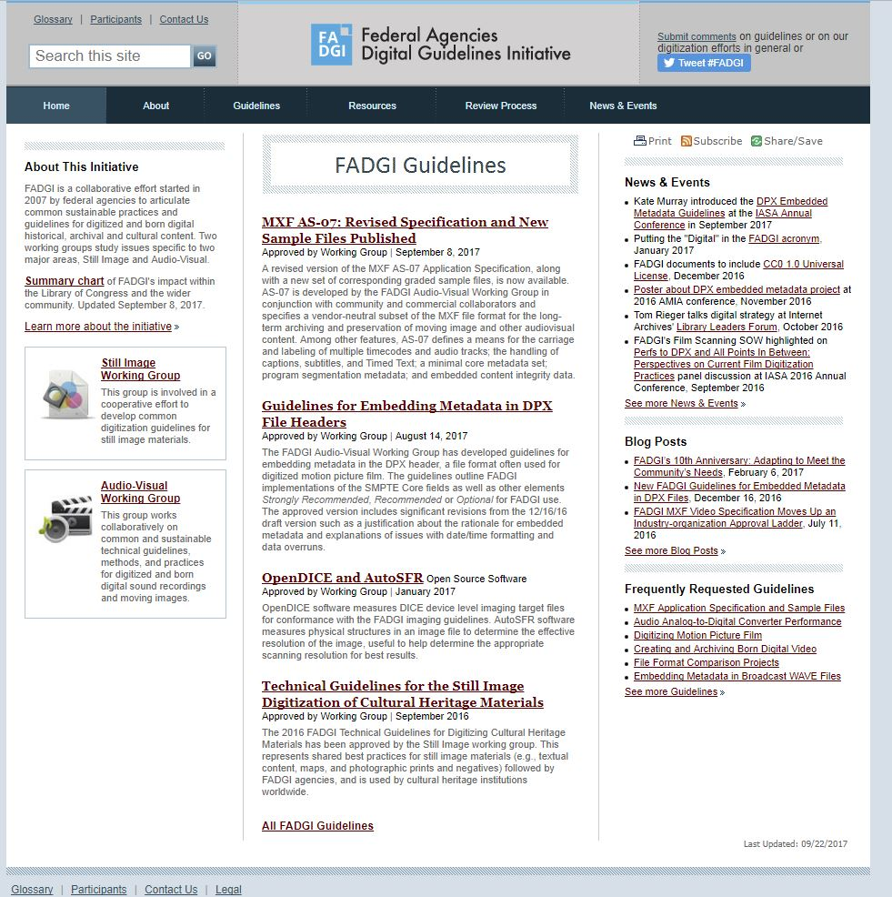
What is FADGI?
Notes:
FADGI is a collaborative effort by federal agencies to articulate common sustainable practices and guidelines for digitized and born digital content. Two working groups study issues specific to two major areas, Still Image and Audio-Visual.
The Still Image Working Group concentrates its efforts on image content such as books, manuscripts, maps, and photographic prints and negatives. The Still Image working group publishes the “Technical Guidelines for the Still Image Digitization of Cultural Heritage Materials” an on-line guide to still image digitization best practices.
The Audio-Visual Working Group focuses its work on sound, video, and motion picture film.
The FADGI standards were developed out of NARA’s 2004 digitization guidelines. Early NARA and FADGI guidelines defined a set of best practices, but it is the emergence of ISO standards such as 19264; improved testing and imaging performance measurement tools; standardized reference targets; and OpenDice or other analysis software that allow for greater confidence for accurate capture of cultural heritage materials.
The overall goal is to create digital products of uniform quality through a common set of benchmarks for digitization service providers and manufacturers. The primary objective is to produce digital master images that look like the original record and that the files Maintain the essential features and information of the original 

Slide 8
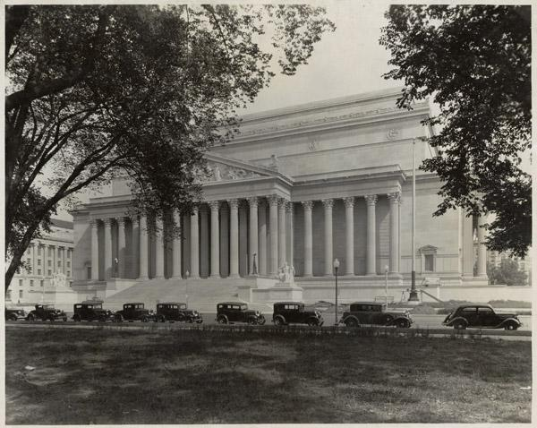
NARA Regulations vs FADGI
FADGI 3* is NOT the requirement
Federal Agencies must comply to NARA Regulations found in 36 CFR 1236
FADGI has good best practices but is not the regulatory authority for compliance
The minimum requirement equates to FADGI Modern Textual records category
You may have to digitize up to equivalent of FADGI 4* to capture all the information
Notes:
FADGI is a guidance document and not a standard, nor is it a regulation. The FADGI guidance consists of an implementation of the ISO aimpoints and tolerances as applied to over 14 different records material types divided into 4 different image quality. NARA has adopted the FADGI quality metrics and Digital image conformance evaluation method. However FADGI is a guidance document intended for an international audience and does not apply to the digitization of permanent federal records.
FADGI 3-star is NOT the requirement Federal Agencies must comply to NARA Regulations found in 36 CFR 1236.
NARA developed A new FADGI category for modern textual records as the minimum. You may have to exceed 3 star for some records to capture all the information.
Similar to FADGI 3* for unbound textual general collections
Designed for modern office records that have white paper and black text
Appropriate for mass digitization greyscale and auto feed scanners
the two darkest patches of target are not measured

Slide 9
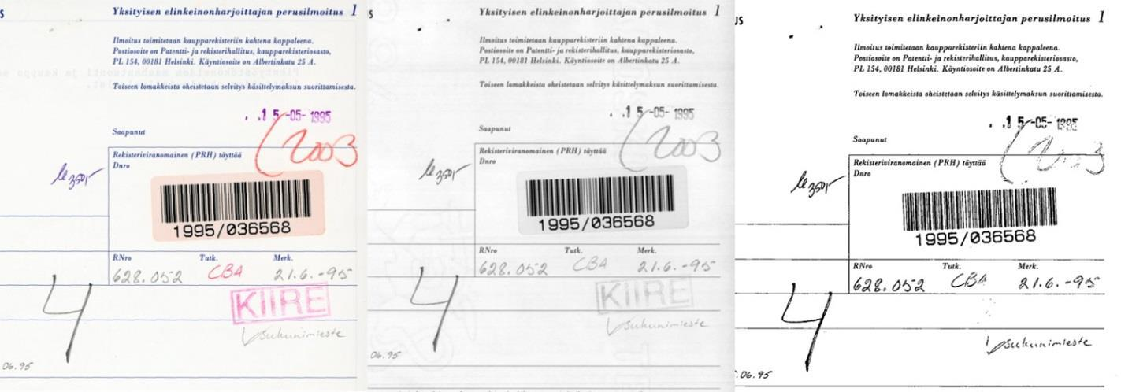
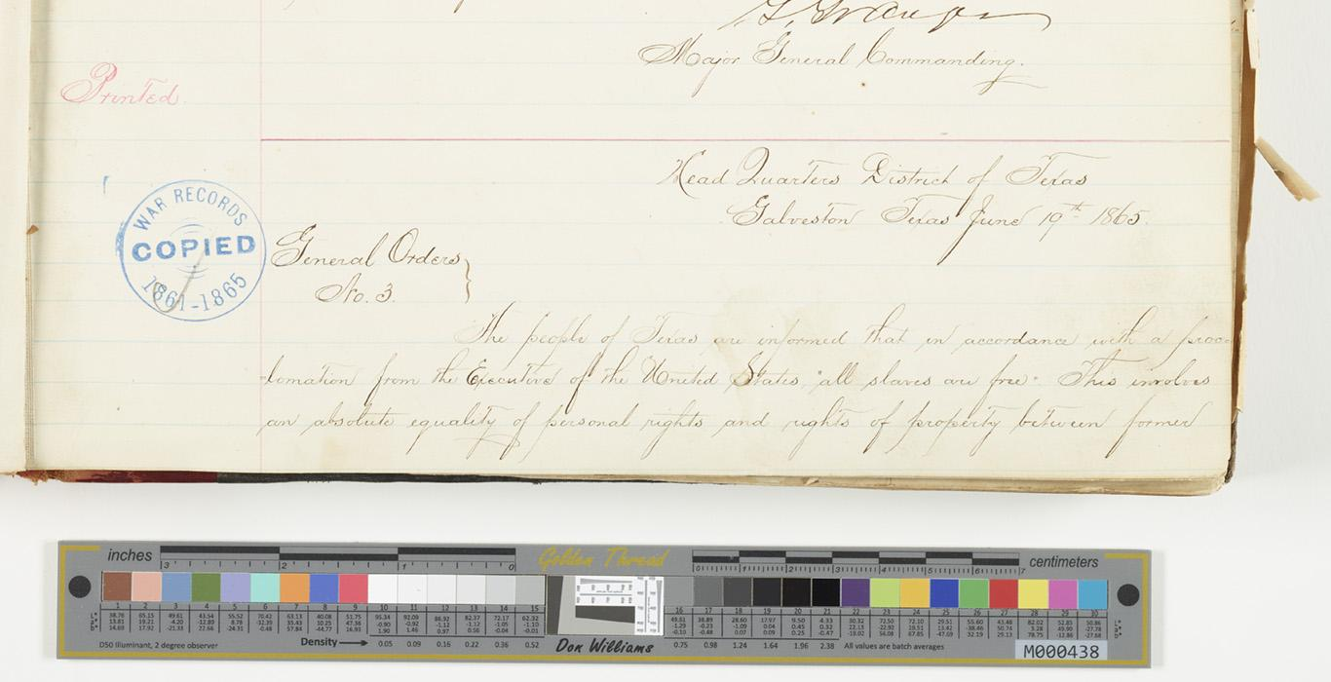
Standards and what they mean for NARA
Why do we need standards?
Color Grayscale Bi-tonal (Black and White)
General Order #3 (Juneteenth) NAID: 182778372
Accurately capture information in the source record (Color, tone, resolution, legibility, free from defects)
Provides objective, repeatable, and measurable requirements
Creates a common technical framework for capture, quality management, and preservation
Ensures that the digital record can serve the same purpose as the original
Notes:
The requirements are based on international technical standards and well established imaging science. As illustrated in this slide the proper application of digitization standards is to capture accurate color, tone, and legibility to ensure that all the information in a source record is recorded. On the left is an example from the national library of finland of the various levels of information loss from color mode, grayscale, and bi-tonal. Notice in the grayscale image the loss of color information which may or may not represent valuable information. In the bi-tonal image you can see a major loss of information because the scanning mode is not able to capture all the information in the source record. NARA’s regulations do not accept bitonal scans because of this risk. The image on the right is an example from NARA’s catalog of a properly imaged record, and it includes in the image area a preservation quality reference target.
Through our participation with (FADGI) and the International Organization for Standardization (ISO) standards work, we have authored a new FADGI category for mass digitization of modern paper records, created a code of ethics for digitizing cultural heritage materials, and we currently participate in the development of new ISO standards for transmissive film records. What sets NARA’s standards apart from other cultural institutions is that we have incorporated a detailed series of records management and quality management requirements that verify system performance and validate that specific criteria have been met. Additionally we are one of the first institutions to incorporate ISO standards and the FADGI methodology as the process to digitally reformat source records.
The regulations have influenced developments in electronic records management solutions for federal agencies, digitization manufacturers and services industries, as well as setting a standard for other cultural heritage institutions to follow. Major digital equipment manufacturing companies have introduced new scanners that meet FADGI and NARA standards. Electronic Records Management service companies have developed solutions to better manage the digitization and records management process, as well as software developers have created new tools to monitor quality management, conformance and validation steps. Finally, the standards create a common ground for the public, archivists, records managers, federal agencies, and the private sector to develop workflows, services, and products.

Slide 10
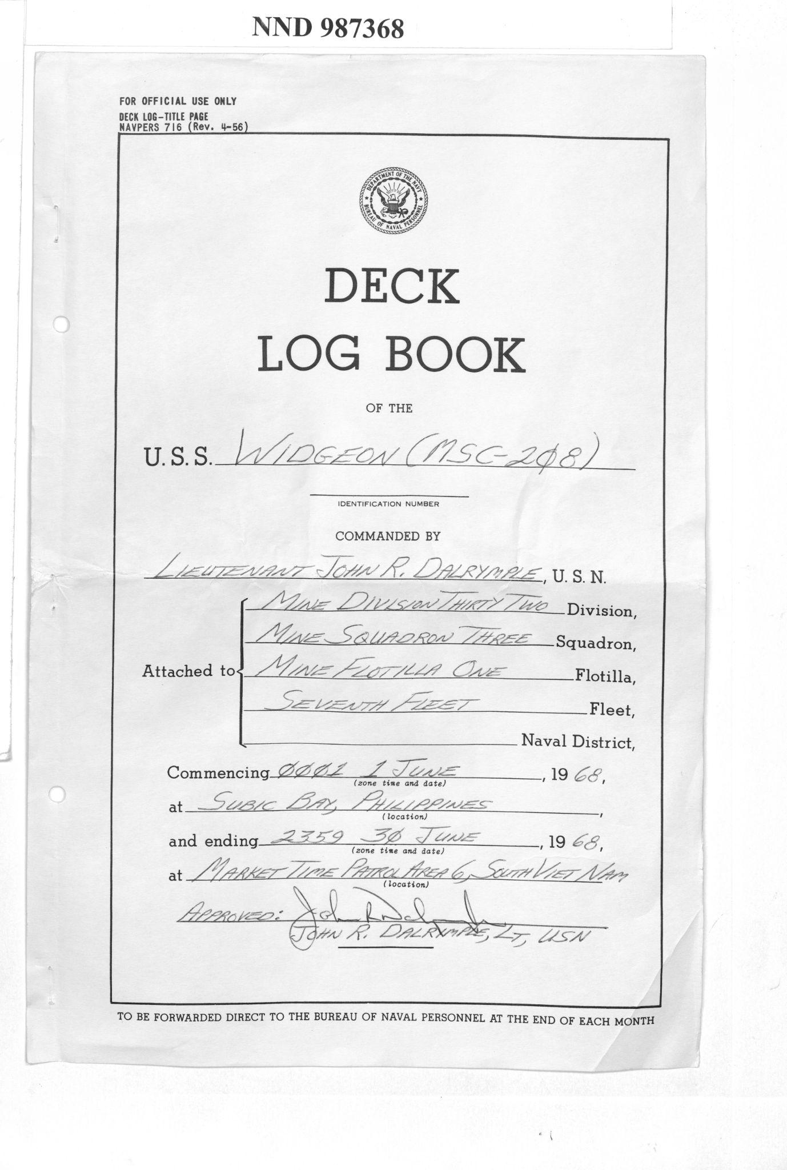
Modern Textual Records
A new FADGI category created by NARA
Similar to FADGI 3* for unbound textual general collections
Designed for modern office records that are white paper and black text
Appropriate for mass digitization greyscale and auto feed scanners
the two darkest patches of target are not measured

Slide 11
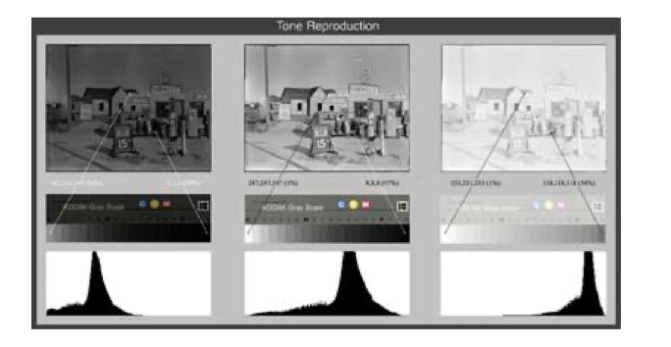
Evaluation Parameters
Sampling Frequency
Tone Response (OECF)
White Balance Error
Lightness Uniformity
Color Accuracy
Color Channel Mis-Registration
SFR* (Spatial Frequency Response)
Reproduction Scale Accuracy
Sharpening
Noise
Skew
Notes:
Image quality is the degree of perceived or objective measurement of a digital image’s overall accuracy in faithfully reproducing an original. A digital image created to a high degree of accuracy meets or exceeds objective performance attributes (such as level of detail, tonal and color fidelity, and correct exposure), and has minimal defects (such as noise, compression artifacts, or distortion).
When images are copied, it is essential that the tones, or brightnesses, are properly reproduced. If the tones are too light or dark, or if the relationship between tones is distorted, image quality suffers. This characteristic closely matches proper exposure in traditional photography. If the image is reproduced overall too light, the image will appear washed out and lack dark shadows. If the image is reproduced too dark, the image will appear flat and lack separation of shadow detail.
A histogram, available in most image processing software applications, is a graphic representation of the relative distribution of tones in an image. This tool is especially useful for verifying an exposure problem. If the original being reproduced has a full range of tones that are normally distributed (i.e. appropriate quantities of shadow, midtone and highlight pixels with smooth transitions throughout), the histogram should exhibit a relatively smooth shape that extends across the entire width of the graph. If the values in the histogram are concentrated at either end of the graph with a significant amount of the graph devoid of values, this indicates that there has been a problem in the process, and the image quality will have suffered. This does not hold true for originals that already are weighted to one end of the tonal scale often described as high or low key images. In such cases, the histogram should reflect the same preponderance of values at the appropriate end of the scale.

Slide 12
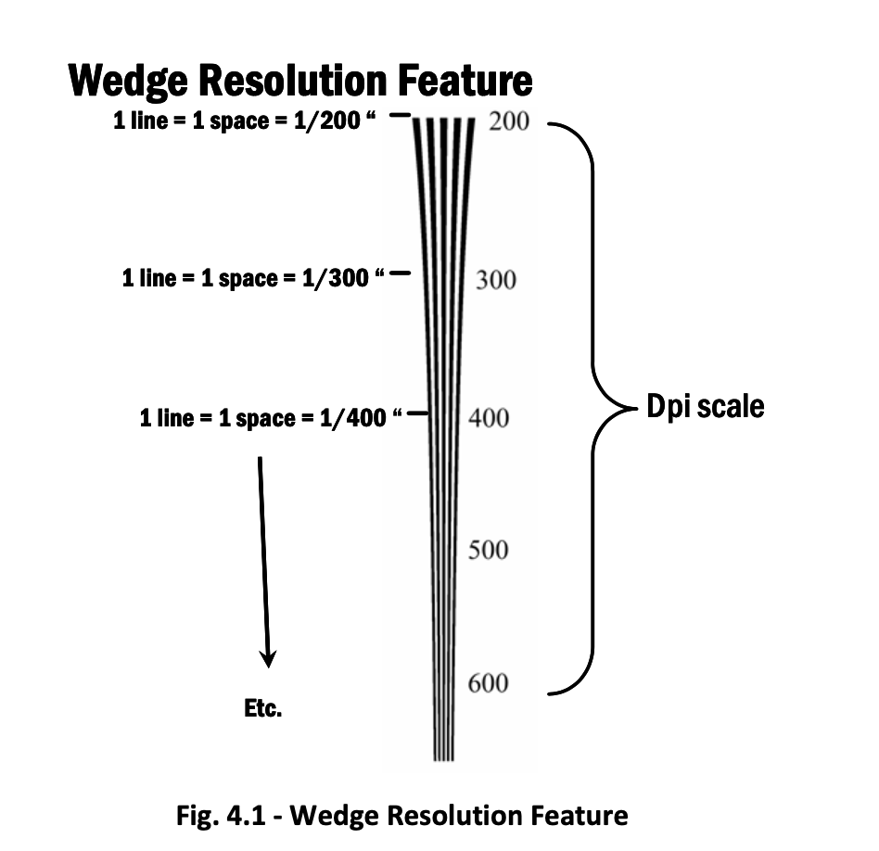
What is image quality and dispelling the myth of dpi
Image quality is a product of several image performance factors
Optical performance, tone reproduction, color fidelity, resolution, and image processing all combine to determine quality
Resolution: “the ability of an imaging system to resolve detail in the object that is being imaged”
Its is not measured by “dpi”
Measured by MTF/SFR analysis
Notes:
The number of pixels in a digital image is not a measure of image resolution.
The term “resolution” in digital imaging is one of the most confusing and misunderstood concepts regarding image quality. Terms such as “dpi” are often used as the sole expression to indicate overall quality with the implication that the higher the dpi or megapixel the better the image.
A more precise definition of resolution is “an imaging system’s ability to resolve finely spaced detail.” Note that the definition does not refer to dpi but to the ability to resolve detail. Image quality is determined by how well the optics and signal processing an image system performs and not the quantity of pixels in a digital file. The quality of a digital image is determined by how accurate the imaging system faithfully reproduces the original subject.
Dpi was an early attempt to relate the input sampling rate of a scanner to the output printing resolutions needed to create digital prints. Researchers determined that the average human eye has a visual acuity close to the equivalent of 300 ppi at a specific viewing distance. Early digital image practitioners generalized that the resolution be set on a flatbed scanner at 300 dpi. In a practical sense dpi is merely the addressable resolution that the device can be set to, but it is only an indication of the sampling interval between pixels. In reality scanners do not sample at a precise rate, and office grade scanners sacrifice speed over quality. A 400 dpi scan on a poor performing device may not be better than a 300 dpi scan on a higher performing device. If the device is out of focus it doesnt matter what the dpi was.
Different types of “resolution”
Another problem is that there are several different types of resolution and methods of measuring the amount of detail in a digital image. Pixel resolution is the number of pixels in a raster image file measured in height and width, such as 2400 x 3500. The number of pixels in a raster image does affect the ability of a file to contain fine detail, but it is the spatial resolution of an image system’s ability to “resolve” detail that gives the perception of sharpness
Spatial resolution is a visual observation of the line pairs of a bar pattern in an image of a test target such as the USAF 1951 chart. An observer looks for the smallest threshold where line pairs or bar patterns are visually distinct. This method also known as vanishing resolution is strongly affected by the observers ability to perceive fine detail and subjective perception that varies by individuals.
ppi/dpi/spi are not measurements of resolution, sharpness, or legibility, they are related to “addressable resolution”
Addressable resolution is a statement or claim what the device can be set to but is not a measurement of performance
Ppi can not be a specification because it is highly variable among devices’ precision of components (moving parts), optical quality (materials), image processing, sensor size.

Slide 13
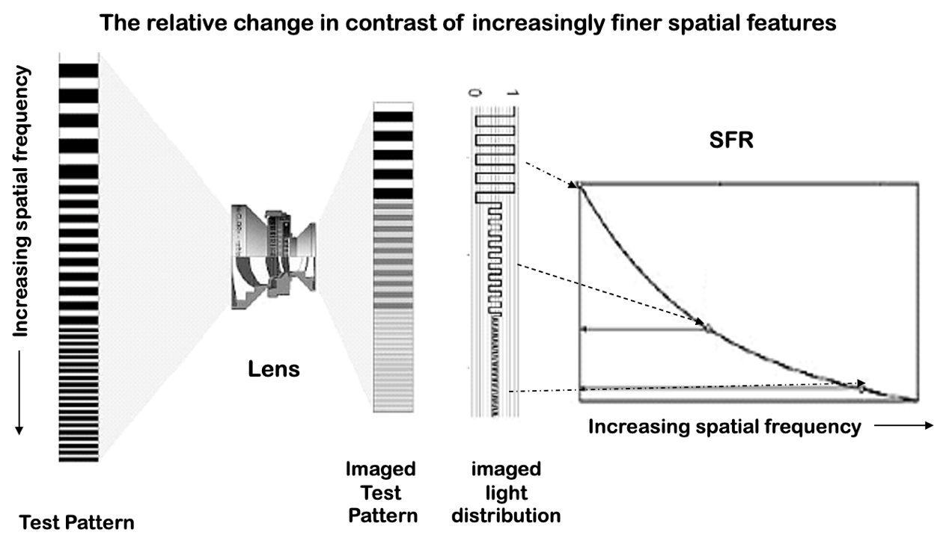
MTF/SFR
Notes:
Different ways of measuring detail
Advances in imaging science have replaced subjective visual evaluation of resolution targets, with the development of objective testing and evaluating methods that measure the optical signal processing accuracy of imaging devices.
Modulation Transfer Function (MTF) is the scientific means of evaluating the fundamental spatial resolution performance of an imaging system, or components of that system. The MTF concept is a superior way of specifying spatial resolution compared to other methods such as dots-per-inch (dpi) or visual bar target readings.
The Spatial Frequency Response or SFR is a surrogate metric to Modulation Transfer Function, MTF. For simplicity FADGI continues to use SFR as the metric in the guidelines.
Resolution is a measure of how well spatial details are preserved. The measuring of two items are required to define it, (1) spatial detail and (2) preservation. It is these fundamental metrics of detail and preservation that define MTF. These detail and preservation metrics are not single measurements, but rather a continuum of measurements, which is why a functional curve quantifying them, i.e., the MTF, can be plotted. A range of spatial details is characterized by how well each and every one of those details is preserved

Slide 14
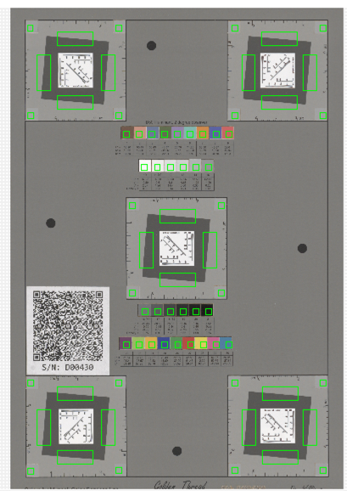
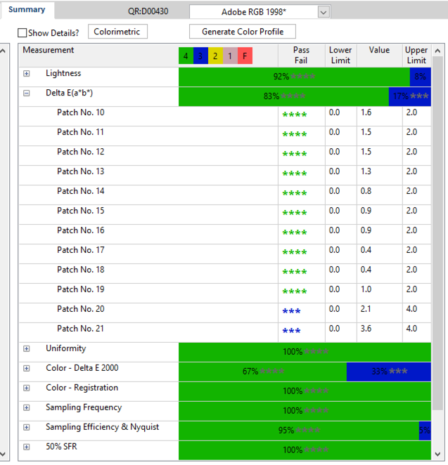
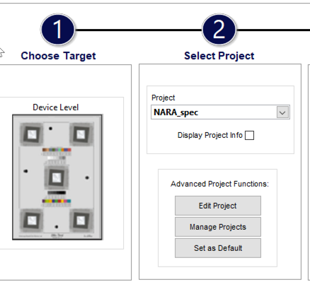
FADGI ISO compliant image analysis workflow
Identify scanned
target
Verify Regions
of metrics
Analyze and report
Notes:
Test targets have been developed to record image performance data that is analyzed by software to create an overall equipment performance score. The score indicates the level of conformance and can be used to calibrate equipment, validate performance elements, and verify that metrics such as resolution and color are within tolerances. This approach is very similar to analogue photographic process control and is a well developed practice in the preservation microfilm and other workflows.
This is a basic representation of a imaging target software analysis interface. Step 1 involves selecting the type of target that will be analyzed, and then selecting the quality level that the result will be analyzed against. The values are a look up table of aimponts and parameter tolerances. The values captured in the scan of the target will be compared to the reference values in the look up table. Values that fall within the aimponts and tolerance have a pass fail, and the values that fall outside the aimponts (depending on the software used) can identify the areas that are falling out of specification.

Slide 15
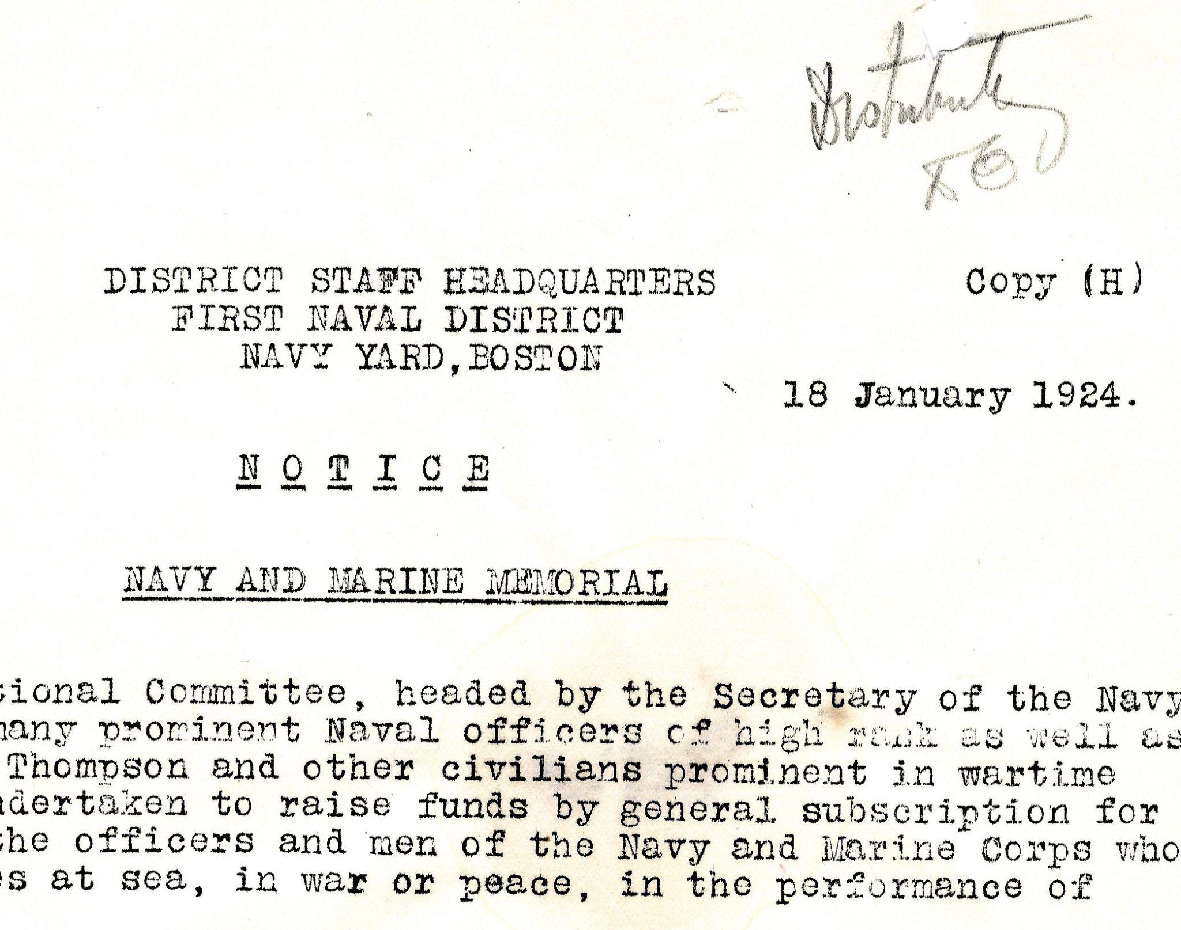
This is why we have standards
Over exposure due to auto settings.
excessive sharpening makes OCR, and other machine learning difficult
Color not necessary to understand content
Could easily been scanned as a grayscale
grayscale saves file size
Notes:
Over exposed, soft edges. Yellow scan from auto exposure.

Slide 16
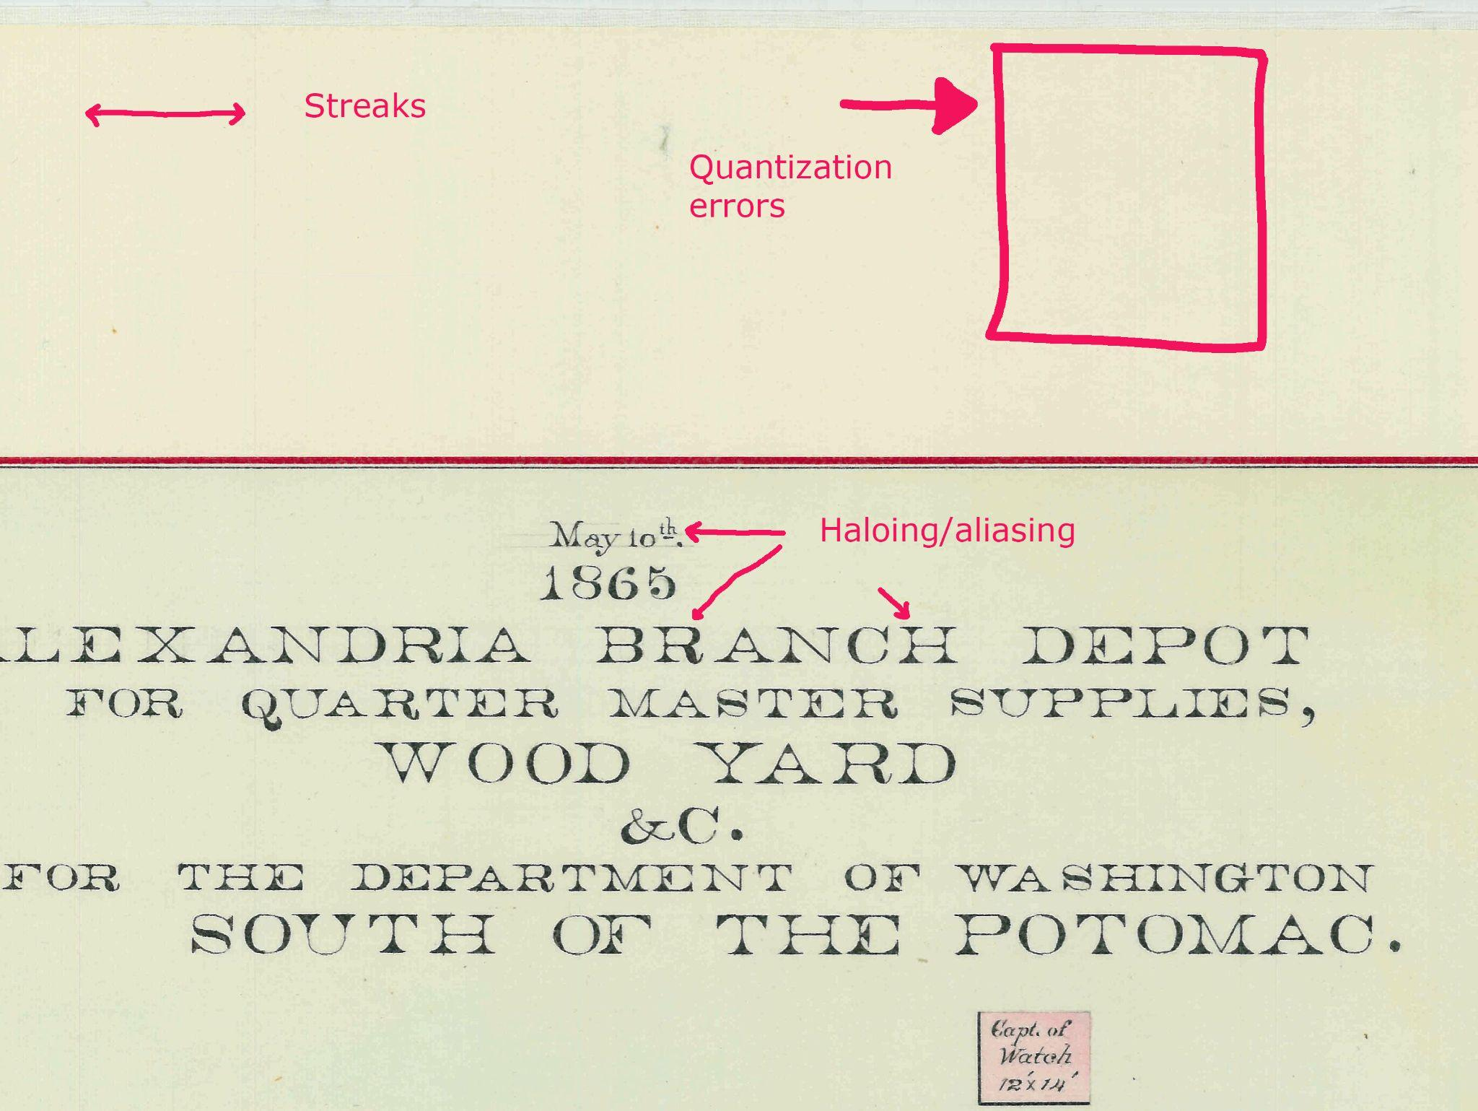
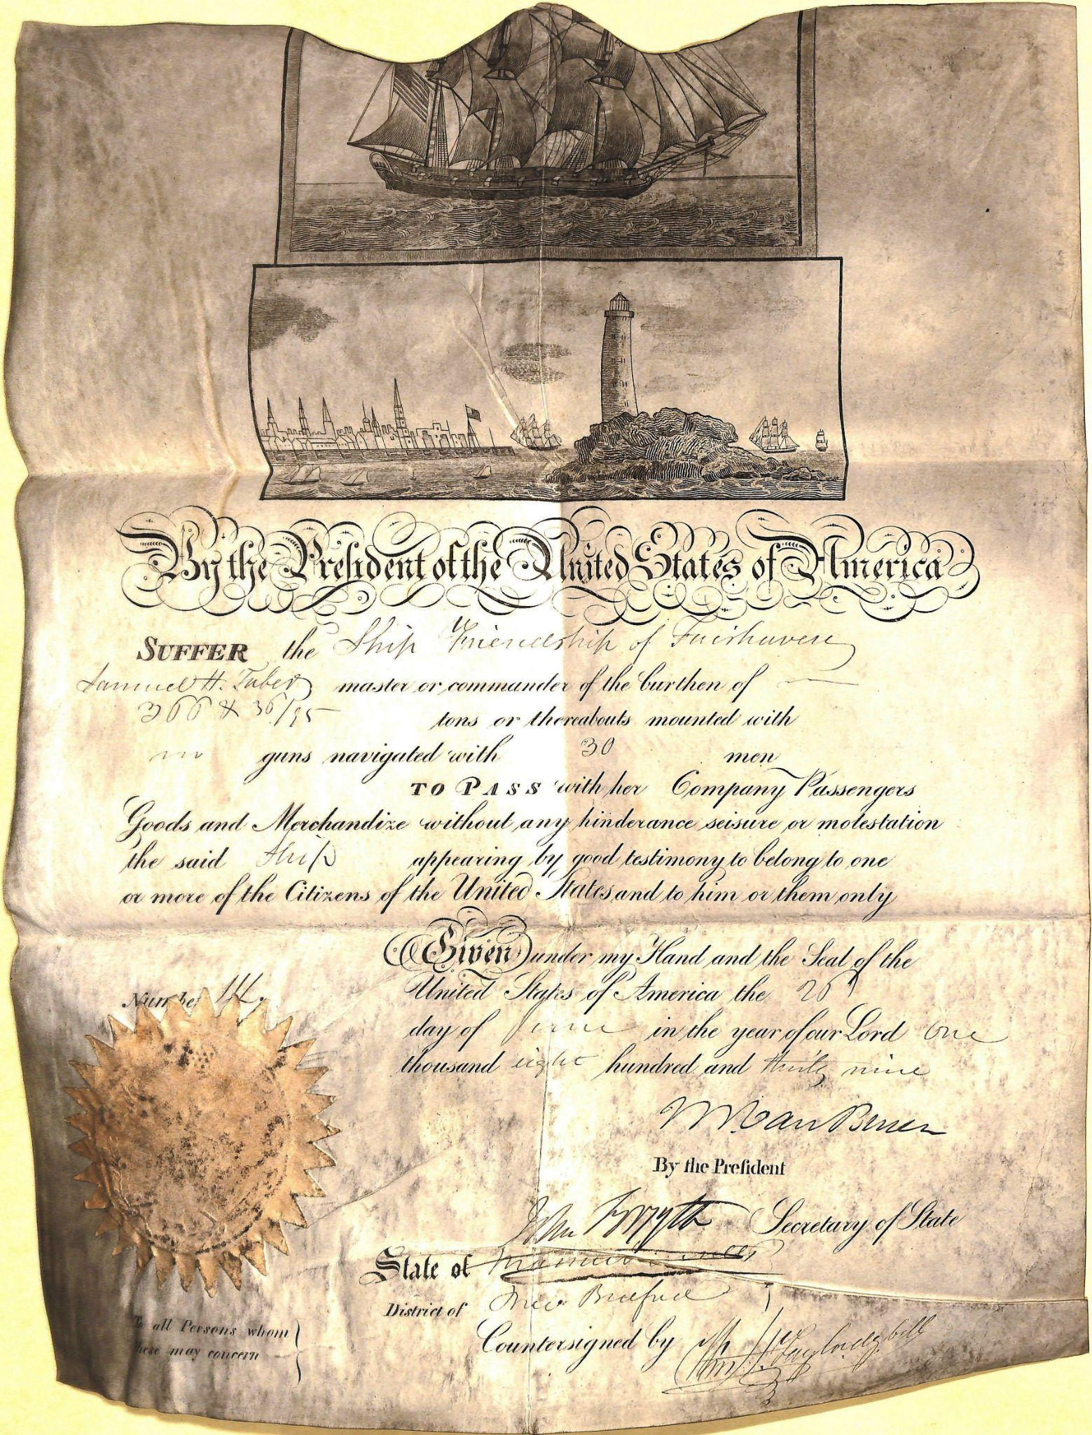
Scanning defects 1
RG92_POSTRES_MAP111_SH37
Notes:
Image defects

Slide 17
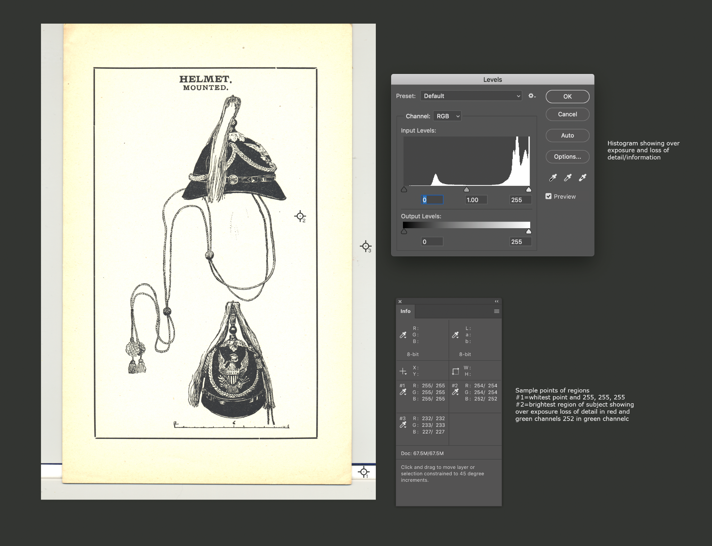
Scanning defects 2
Clipping of highlights due to auto exposure settings.
White stripe at bottom is a white balance and exposure reference
Notes:
Yellow scan. Histogram shows overexposed (Clipped) highlight values on the right. Sample points on the subject, white backing board, and white calibration strip give RGB values.

Slide 18
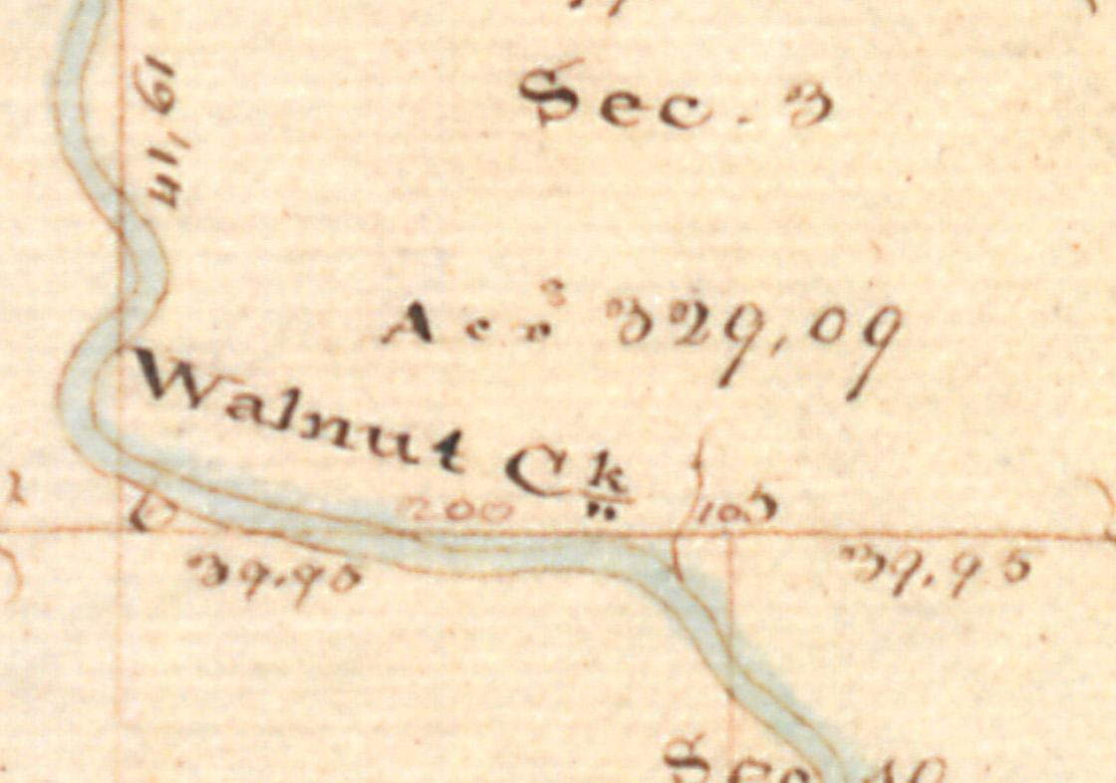
Scanned at 600 ppi but out of focus
Color Model: RGB
Depth: 8
DPI Height: 600
DPI Width: 600
Orientation: 1 (Normal)
Pixel Height: 786
Pixel Width: 1,120
Profile Name: OS12000_A1_mG
Notes:
Out of focus 25MB Jpeg
Either the focus got out of calibration, or the object was placed on top of the glass
Lots of compression artifacts

Slide 19
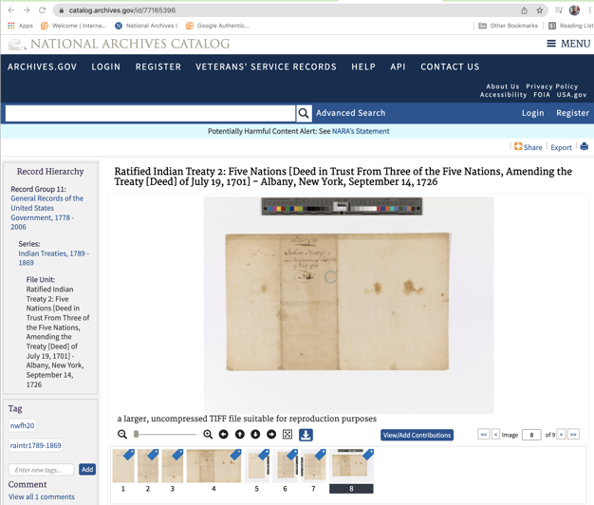
This is why we have standards 1

Slide 20
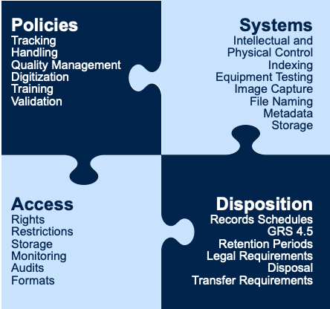
Guidance and Resources:
Success Criteria White Paper
Notes:
Assists agencies in digitizing permanent records and meeting federal records management requirements in laws, regulations, and NARA-issued policy.
Helps agencies adhere to the requirements in 36 CFR 1236 subpart E, and other recordkeeping requirements, to help mitigate many of the risks inherent in digitization.
Provides high-level success criteria for digitizing permanent records, which are organized around four key concepts: Policies, Access, Systems, and Disposition.
If not properly managed, digitization can result in incomplete/insufficient digital record quality to serve all of the same business purposes as the originals.
Policies for:
Roles and responsibilities
Procedures for handling source records
Digitizing source records
Quality management
Managing digital records

Slide 21
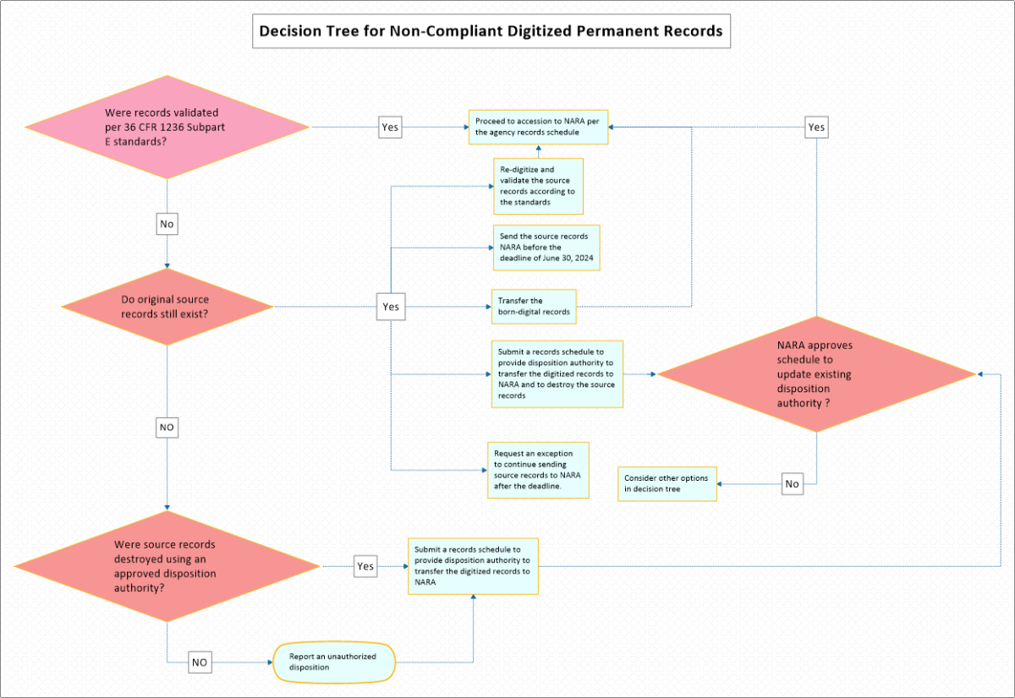
Guidance and Resources:
Non-Compliant Digitized Records
https://www.archives.gov/records-mgmt/policy/non-compliant-digitized
Notes:
Non-compliant digitized records do not meet the standards in the regulations.
Options:
Submit a new records schedule
Re-digitize and validate the source records according to the standards
Transfer the born-digital records
Send the source records to NARA before June 30, 2024
Media-neutral records schedules and NA 13171 notifications

Slide 22
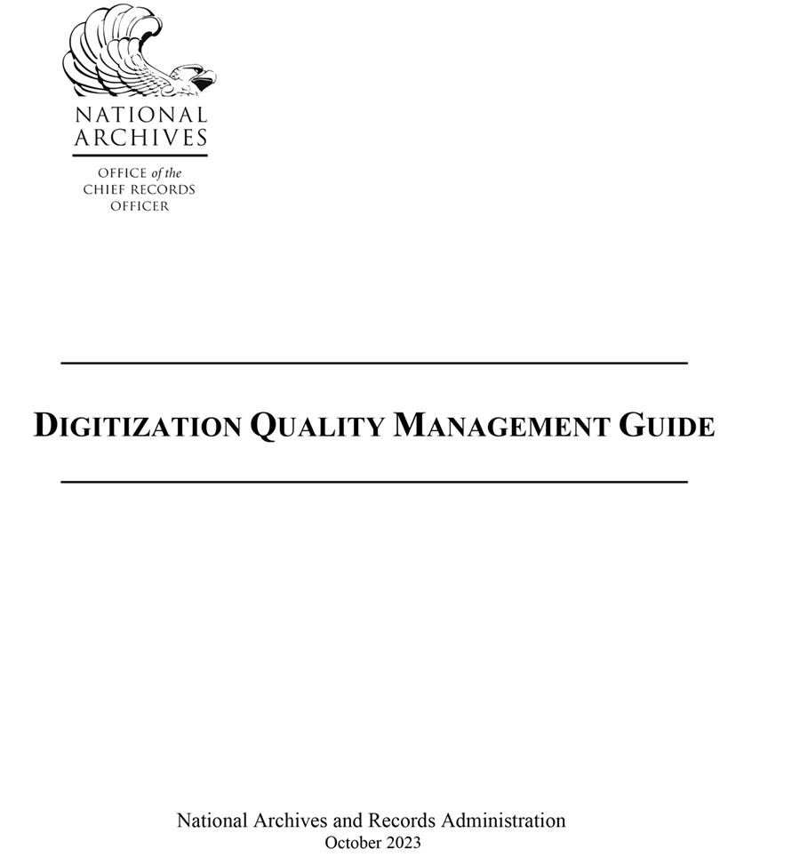
Guidance and Resources:
Quality Management Guide
Quality management (QM) is the overall management function and underlying activities that determine quality
Quality assurance (QA) is a proactive quality management (QM) activity focused on preventing defects.
A QA program is heavily dependent on quality control (QC) data to search for patterns and trends.
Notes:
The goal of quality management (QM) in a digitization project is to prevent defects before they happen. Prevention of defects is the most efficient, cost-effective, and productive activity in a digitization workflow. Digitization is an image manufacturing process that relies upon quality assurance (QA) to establish specifications and requirements, and a quality control (QC) process to test for and inspect defects. A well-run digitization operation will be proactive rather than rely upon QC inspection to achieve quality.
NARA’s digitization regulations could be considered a total quality management document that brings together records management practices, digital imaging quality standards, quality control, inspection, and validation steps. Each phase of a digitization project affects the other parts. For example, establishing intellectual and physical control contributes to creating metadata as well as identifying missing records. The quality control and inspection steps have been optimized to rely on automated processes where possible and limit human inspection to the phases that cannot be automated. By relying on objective testing and analysis for image quality, we eliminate wasteful subjective inspection of attributes. Finally, the validation phase is a high-level review to verify that all the requirements of a project have been met and the digital surrogates can serve the same legal and evidentiary purpose as the source records.

Slide 23
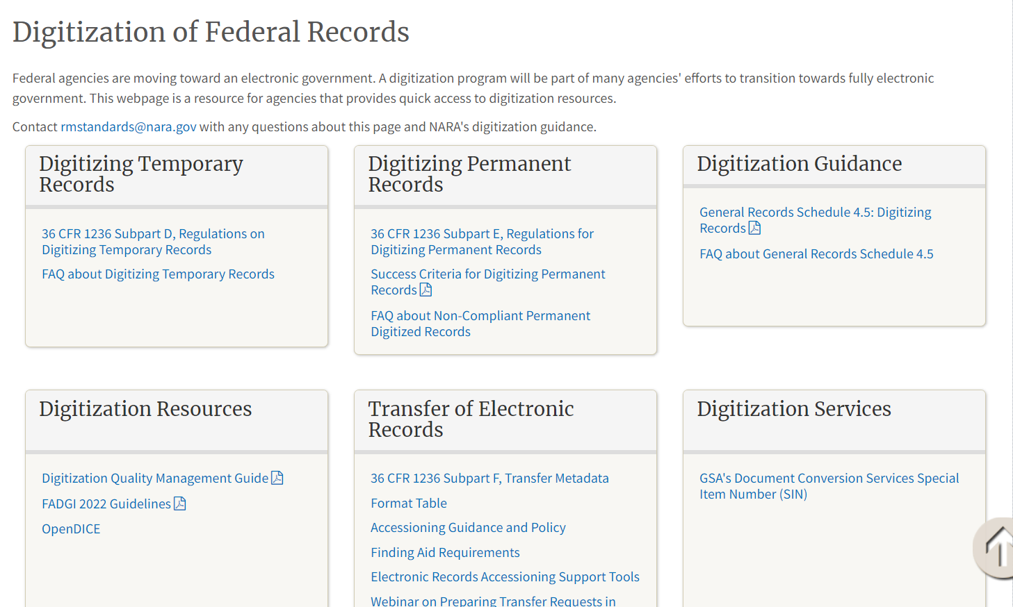
NARA Digitization Resources Page
https://www.archives.gov/records-mgmt/policy/digitization
Notes:
Lisa

Slide 24
Key Takeaways
Read the Regulation
Read the FADGI guidelines
The regulation is the statutory authority that agencies must follow, NOT FADGI
FADGI 3* is NOT the requirement
Modern Textual is the minimum but may have to go up to FADGI 4*
Agencies self certify, NARA is not inspecting or approving workflows
Work with GSA, your general counsel, or budget office
Digitization at this scale is a image manufacturing process, not a digital mailroom operation
The standards are high because the originals will be destroyed

Slide 25
Contact Information
Michael Horsley
Sevior Electronic Records Policy Analyst
Records Management and Policy Team
Records Management Policy and Outreach Program
Office of the Chief Records Officer
Agency Services
michael.horsley@nara.gov

